Slide 1
inheritance

Slide 2
inheritance
“Allow you to create a new class called derived class from the existing class. Derived class can inherit all features of base class and can add new features of its own.”
class base_class{ };
class derived_class:member Access Specifier base_class { };

Slide 3
Member Access Specifier | How member of base class appear in derive class ?
Private | Private – X
 | Protected – private
 | Public – private
Protected | Private – X
 | Protected – protected
 | Public – protected
Public | Private – X
 | Protected - Protected
 | Public - public

Slide 4
Types
Single – One derived class inherit from one base class.
Multiple – single derived class inherit from two or more base classes.
Hierarchical inheritance – multiple derived classes from single base class.
Multi-level – derived class from a class, which inturns inherits from one other class.
Hybrid(virtual) – any legal combination out of four type of inheritance.

Slide 5
Function overloading
“two or more functions can have the same name with in same scope but either the number of arguments or data type has to be different”
Note – return type has no role in function overloading.
Example – “func_over.cpp”

Slide 6
Friend function
A friend function has access to all private and protected members of the class for which it is friend.
Friend function is non-member function of the class.
Example “friend_fun.cpp”
A function can be friend of multiple class.
Example “friend_function.cpp”

Slide 7
Function pointer
Example “function_pointer.cpp”

Slide 8
Friend function
Member function of the class can be the friend of another class.
Example “friend_function1.cpp”

Slide 9
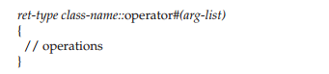
Operator overloading

Slide 10
Operator overloading
Example “overloading_+.cpp”

Slide 11
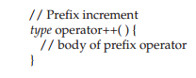
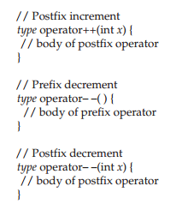
overloading
Pre and post increament/decreament

Slide 12
Pre/post increment
Example “operator_pre_post.cpp”.

Slide 13
Restrictions
Operator precedence cant be altered.
You cant change the number of operands that an operator takes.
. :: .* ? cant be overloaded.

Slide 14
Operator overloading with friend function
Example “overloading+friend.cpp”

Slide 15
Example
“friend_test.cpp”
“friend_test1.cpp”

Slide 16
Polymorphism
Polymorphism can be achieved both at compile time and run-time.
Compile time Polymorphism can be achieved by functions overloading and operators overloading.
Runtime Polymorphism can be achieved by using inheritance and virtual functions.

Slide 17
Virtual Function
Virtual function is the member function that is declare in the base class and redefine in the derived class.
When a class containing virtual function is inherited, the derived class redefines the virtual function to fit its own needs.

Slide 18
Virtual function
Which version of the virtual function is called is determine by the type of object is pointed by the base pointer, this determination is made at the runtime. It is called runtime Polymorphism.
Virtual functions are used to achieve late-binding.
The term overriding is used to describe virtual function redefinition by a derived class.

Slide 19
Example
“virtual_function.cpp”

Slide 20
Virtual functions
Virtual functions are hierarchical in nature.
Example “virtual_function1.cpp”

Slide 21
Pure virtual function
No definition in the base class.
Ensure that all the derived class must override the virtual function.
General form
virtual type func-name(para list) = 0;
Example “pure_virtual1.cpp”

Slide 22
Abstract class
Class that contain atleast one pure virtual function is known as abstract class.
Object of the abstract class cant be created, but the pointer or reference can be created.
This allow abstract class to support runtime Polymorphism.
Example

Slide 23
Generic Functions
GF defines a general set of operations that will be applied to various types of data. The type of data that the function will operate upon passes to it as a parameter.
Through a GF a single general procedure can be applied to wide range of data.
In essence when you create a GF you are creating a function that can automatically overload itself.
A GF is created using the keyword “template”.

Slide 24
Syntax
template <class Ttype> ref_type func_name(para list){
------
------
}
Here Ttype is the placeholder name of the data type used by the function. This name may be use with in the function definition.
However, it is only a placeholder that the compiler will automatically replace with an actual datatype when it creates a specific version of the function.

Slide 25
Example
“template_function.cpp”
“template_function1.cpp”

Slide 26
Generic classes
**Assignment to be given**
GC are useful when the class use logic that can be generalized.
Syntax
template <class Ttype> class class_name{
------
------
};

Slide 27
Ttype is the placeholder type name, which will be specified when a class is instantiated. If, necessary you can define more than one generic datetype using comma.
Once you have created a GC, you create a specific instance of that class using the following general form:
class_name <type> ob;
type is the type name of the data that the class will be operating upon.
Member functions of the GC are automatically generic.

Slide 28
Example
“template_class.cpp”
“template_class1.cpp”

Slide 29
Copy constructor
Example
“copy_constructor.cpp”
“copy_constructor1.cpp”
“copy_constructor2.cpp”

Slide 30
Exception handling
try – block of program statements that are monitored for the exception(error).
catch – if the exception occurs with in the try block it is thrown(using throw). And exception is caught using catch and processed.

Slide 31
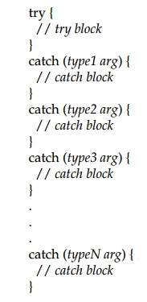
General form of try and catch

Slide 32
example
Single try block can have multiple catch and the catch to be executed will be identified by the type of value thrown by the try block.
try_catch.cpp

Slide 33
Example
If the exception is caught then throw must be executed either from within the try block or from any function called from try block.
try_catch_1.cpp

Slide 34
Example
Exception can be of class type
Try_catch_2.cpp

Slide 35
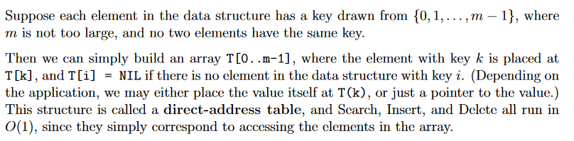
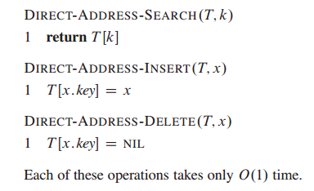
Direct Address Tables

Slide 36
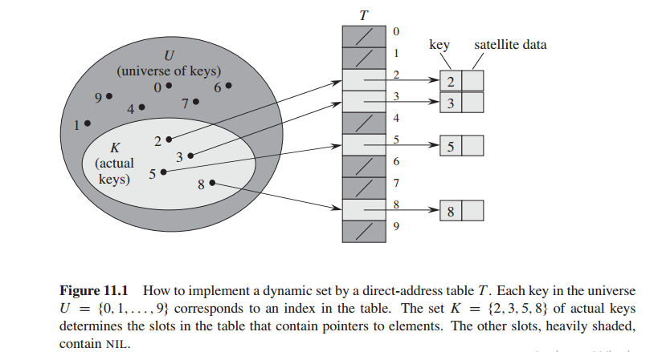
Direct Address Table

Slide 37
Example
Suppose that we have to store the data of 5 students from the class of 20 students, whose roll number fall between 0 – 19.
Now 0-19 is the set of universal keys U.
And may be the roll numbers of the 5 students are {4, 16, 6, 18, 3} then these keys are set of actual keys to be stored.
Now we form direct address table using array which is of equal size as of U that is from 0 – 19.
And actual keys are directly stored in the same index of direct address table.
Black cell representing the NIL
0 | 1 | 2 | 3 | 4 | 5 | 6 | 7 | 8 | 9 | 10 | 11 | 12 | 13 | 14 | 15 | 16 | 17 | 18 | 19
 |  |  | 3 | 4 |  | 6 |  |  |  |  |  |  |  |  |  | 16 |  | 18

Slide 38
Hash Tables
A hash table is an effective data structure for implementing
dictionaries. That supports only the dictionary operations
INSERT, SEARCH, and DELETE.
Although searching for an element in a hash table can take
as long as searching for an element in a linked list—θ(n) time
in the worst case—in practice, hashing performs extremely well.
Under reasonable assumptions, the average time to search for an
element in a hash table is O(1).

Slide 39
Hash Table
The downside of direct addressing is obvious: if the universe U is large, storing table T of size |U| may be impractical, or even impossible, given the memory available on a typical computer. Furthermore, the set K of keys actually stored may be so small relative to U that most of the space allocated for T would be wasted

Slide 40
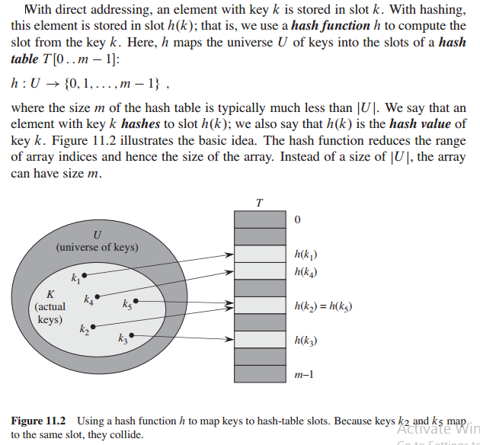
Hash table

Slide 41
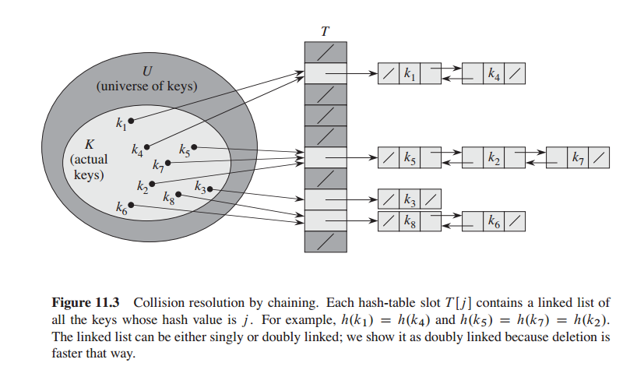
Collision resolution by chaining

Slide 42
Example
Suppose that we have to store the data of 5 students whose roll number fall between 0 – 19.
Now 0-19 is the set of universal keys U.
And may be the roll numbers of the 5 students are {4, 16, 6, 18, 3} then these keys are set of actual keys to be stored.
Now we form Hash table using array size much lesser than the U, suppose we consider the hash function h(k) = k mod 10. So now all the hash values will be fall between 0 – 9. So the size of the hash table will be 10.
And hash keys will be stored in the hash table with same index. And the collision will be resolved using chaining with linked list (single/double).
Black cell representing the NIL
0 | 1 | 2 | 3 | 4 | 5 | 6 | 7 | 8 | 9
 |  |  | 3 | 4 |  | 16,6 |  | 18

Slide 43
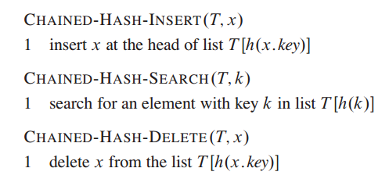
Collision resolution by chaining

Slide 44
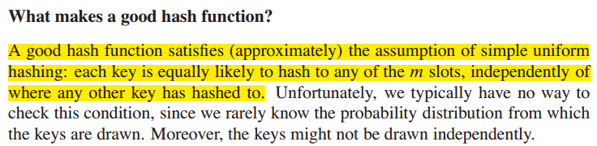
Hash function
A good hash function would minimize the chance that such variants hash to the same slot (collision).

Slide 45
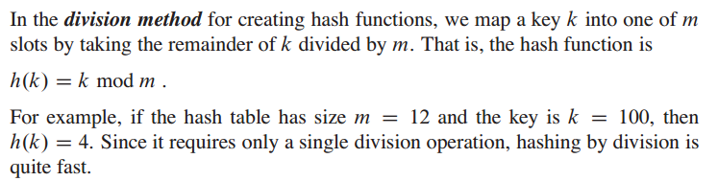
Division method
We should avoid value of m as exact power of 2. A prime not too close to an exact power of 2 is often a good choice for m

Slide 46
1. What is a hash table? a) A structure that maps values to keys b) A structure that maps keys to values c) A structure used for storage d) A structure used to implement stack and queue
✔

Slide 47
1. What is direct addressing? a) Distinct array position for every possible key b) Fewer array positions than keys c) Fewer keys than array positions d) None of the mentioned
✔

Slide 48
2. If several elements are competing for the same bucket in the hash table, what is it called? a) Diffusion b) Replication c) Collision d) None of the mentioned
✔

Slide 49
4. What is the search complexity in direct addressing? a) O(n) b) O(logn) c) O(nlogn) d) O(1)
✔

Slide 50
5. What is a hash function?
a) A function has allocated memory to keys b) A function that computes the location of the key in the array c) A function that creates an array d) None of the mentioned
✔

Slide 51
6. In a hash table of size 10, where is element 7 placed? a) 6 b) 7 c) 17 d) 16
✔

Slide 52
7. In simple chaining, what data structure is appropriate? a) Singly linked list b) Doubly linked list c) Circular linked list d) Binary trees
✔

Slide 53
8. Hashing is the problem of finding an appropriate mapping of keys into addresses. a) True b) False
✔

Slide 54
Given the following input (4322, 1334, 1471, 9679, 1989, 6171, 6173, 4199) and the hash function x mod 10, which of the following statements are true?
(GATE CS 2004)
i. 9679, 1989, 4199 hash to the same value ii. 1471, 6171 has to the same value iii. All elements hash to the same value iv. Each element hashes to a different value
(A) i only (B) ii only (C) i and ii only (D) iii or iv

Slide 55
Solution.
Using given hash function h(x) = x mod 10
h(9679) = 9679%10 = 9
h(1989) = 1989%10 = 9
h(4199) = 4199%10 = 9
h(1471) = 1471%10 = 1
h(6171) = 6171%10 = 1
As we can see, 9679, 1989 and 4199 hash to same value 9
Also, 1471 and 6171 hash to same value.
1. Therefore, option (C) is correct.

Slide 56
Open addressing
Open addressing is a method for handling collisions (no chaining). In Open Addressing, all elements are stored in the hash table itself.
To perform insertion using open addressing, we successively examine, or probe, the hash table until we find an empty slot in which to put the key.
Instead of being fixed in the order 0,1…m-1, the sequence of positions probed depends upon the key being inserted.
Where m is the hash table size.

Slide 57
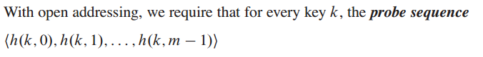
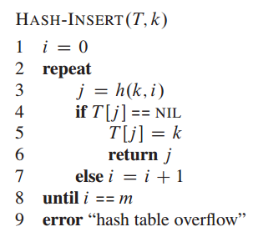
Open addressing

Slide 58
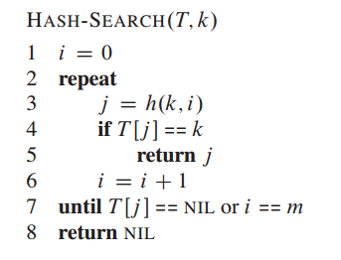
Open addressing

Slide 59
S.No. | Seperate Chaining | Open Addressing
1. | Chaining is Simpler to implement. | Open Addressing requires more computation.
2. | In chaining, Hash table never fills up, we can always add more elements to chain. | In open addressing, table may become full.
3. | Chaining is Less sensitive to the hash function or load factors. | Open addressing requires extra care for to avoid clustering and load factor.
4. | Chaining is mostly used when it is unknown how many and how frequently keys may be inserted or deleted. | Open addressing is used when the frequency and number of keys is known.
5. | Cache performance of chaining is not good as keys are stored using linked list. | Open addressing provides better cache performance as everything is stored in the same table.
6. | Wastage of Space (Some Parts of hash table in chaining are never used). | In Open addressing, a slot can be used even if an input doesn’t map to it.
7. | Chaining uses extra space for links. | No links in Open addressing

Slide 60
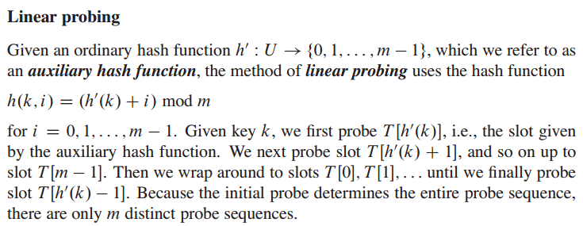
Linear probing
Long runs of occupied slots build up, increasing the average search time.

Slide 61
Example linear probing insert
H_{L} = [h(k) + i] % m
m = 13 is the size of hash table.
h(k) = k % m (auxiliary hash function)
1, 17, 29, 37, 45, 47, 59, 81
Insert – 1 = [(1 % 13) + 0 ] % 13 = 1
Insert – 17 = [(17 % 13) + 0 ] % 13 = 4
Insert – 29 = [(29 % 13) + 0 ] % 13 = 3
Insert – 37 = [(37 % 13) + 0 ] % 13 = 11
Insert – 45 = [(45 % 13) + 0 ] % 13 = 6
Insert – 47 = [(47 % 13) + 0 ] % 13 = 8
Insert – 81 = [(81 % 13) + 0 ] % 13 = 3 (collision)
Insert – 81 = [(81 % 13) + 1 ] % 13 = 4 (collision)
Insert – 81 = [(81 % 13) + 2 ] % 13 = 5
0
1 | 1
2
3 | 29
4 | 17
5 | 81
6 | 45
7
8 | 47
9
10
11 | 37
12

Slide 62
Example linear probing search
H_{L} = [h(k) + i] % m
m = 13 is the size of hash table.
h(k) = k % m
Search - 45
J = [(45 % 13) + 0 ] % 13 = 6 (Found)
Search - 81
J = [(81 % 13) + 0 ] % 13 = 3 (Not Found)
= [(81 % 13) + 1 ] % 13 = 4 (Not Found)
= [(81 % 13) + 2 ] % 13 = 5 (Found)
0
1 | 1
2
3 | 27
4 | 4
5 | 81
6 | 45
7
8 | 47
9
10
11 | 37
12

Slide 63
What is a Hash Table ?
The simplest kind of hash table is an array of records.
This example has 701 records.
[ 0 ]
[ 1 ]
[ 2 ]
[ 3 ]
[ 4 ]
[ 5 ]
[ 700]
. . .
An array of records
Notes:
This lecture introduces hash tables, which are an array-based method for implementing a Dictionary. You should recall that we have seen dictionaries implemented in other ways, for example with a binary search tree. The abstract properties of a dictionary remain the same: We can insert items in the dictionary, and each item has a key associated with it. When we want to retrieve an item, we specify only the key, and the retrieval process finds the associated data.
What we do now is use an array to implement the dictionary. The array is an array of records. In this example, we could store up to 701 records in the array.

Slide 64
What is a Hash Table ?
[ 4 ]
Number 506643548
Each record has a special field, called its key.
In this example, the key is a long integer field called Number.
[ 0 ]
[ 1 ]
[ 2 ]
[ 3 ]
[ 4 ]
[ 5 ]
[ 700]
. . .
Notes:
Each record in the array contains two parts. The first part is a number that we'll use for the key of the item. We could use something else for the keys, such as a string. But for a hash table, numbers make the most convenient keys.

Slide 65
What is a Hash Table ?
[ 4 ]
Number 506643548
The number might be a person's identification number, and the rest of the record has information about the person.
[ 0 ]
[ 1 ]
[ 2 ]
[ 3 ]
[ 4 ]
[ 5 ]
[ 700]
. . .
Notes:
The numbers might be identification numbers of some sort, and the rest of the record contains information about a person. So the pattern that you see here is the same pattern that you've seen in other dictionaries: Each entry in the dictionary has a key (in this case an identifying number) and some associated data.

Slide 66
What is a Hash Table ?
When a hash table is in use, some spots contain valid records, and other spots are "empty".
[ 0 ]
[ 1 ]
[ 2 ]
[ 3 ]
[ 4 ]
[ 5 ]
[ 700]
Number 281942902
Number 233667136
Number 506643548
. . .
Number 155778322
Notes:
When a hash table is being used as a dictionary, some of the array locations are in use, and other spots are "empty", waiting for a new entry to come along.
Oftentimes, the empty spots are identified by a special key. For example, if all our identification numbers are positive, then we could use 0 as the Number that indicates an empty spot.
With this drawing, locations [0], [4], [6], and maybe some others would all have Number=0.

Slide 67
Inserting a New Record
Number 580625685
In order to insert a new record, the key must somehow be converted to an array index.
The index is called the hash value of the key.
[ 0 ]
[ 1 ]
[ 2 ]
[ 3 ]
[ 4 ]
[ 5 ]
[ 700]
Number 281942902
Number 233667136
Number 506643548
. . .
Number 155778322
Notes:
In order to insert a new entry, the key of the entry must somehow be converted to an index in the array. For our example, we must convert the key number into an index between 0 and 700. The conversion process is called hashing and the index is called the hash value of the key.

Slide 68
Inserting a New Record
Number 580625685
Typical way create a hash value:
(Number mod 701)
What is (580625685 mod 701) ?
[ 0 ]
[ 1 ]
[ 2 ]
[ 3 ]
[ 4 ]
[ 5 ]
[ 700]
Number 281942902
Number 233667136
Number 506643548
. . .
Number 155778322
Notes:
There are many ways to create hash values. Here is a typical approach.
a. Take the key mod 701 (which could be anywhere from 0 to 700).
So, quick, what is (580,625,685 mod 701) ?

Slide 69
Inserting a New Record
Number 580625685
Typical way to create a hash value:
(Number mod 701)
3
What is (580625685 mod 701) ?
[ 0 ]
[ 1 ]
[ 2 ]
[ 3 ]
[ 4 ]
[ 5 ]
[ 700]
Number 281942902
Number 233667136
Number 506643548
. . .
Number 155778322
Notes:
Three.

Slide 70
Inserting a New Record
Number 580625685
The hash value is used for the location of the new record.
[3]
[ 0 ]
[ 1 ]
[ 2 ]
[ 3 ]
[ 4 ]
[ 5 ]
[ 700]
Number 281942902
Number 233667136
Number 506643548
. . .
Number 155778322
Notes:
So, this new item will be placed at location [3] of the array.

Slide 71
Inserting a New Record
The hash value is used for the location of the new record.
[ 0 ]
[ 1 ]
[ 2 ]
[ 3 ]
[ 4 ]
[ 5 ]
[ 700]
Number 281942902
Number 233667136
Number 580625685
Number 506643548
. . .
Number 155778322
Notes:
The hash value is always used to find the location for the record.

Slide 72
Collisions
Number 701466868
Here is another new record to insert, with a hash value of 2.
My hash
value is [2].
[ 0 ]
[ 1 ]
[ 2 ]
[ 3 ]
[ 4 ]
[ 5 ]
[ 700]
Number 281942902
Number 233667136
Number 580625685
Number 506643548
. . .
Number 155778322
Notes:
Sometimes, two different records might end up with the same hash value.

Slide 73
Collisions
Number 701466868
This is called a collision, because there is already another valid record at [2].
When a collision occurs,
move forward until you
find an empty spot.
[ 0 ]
[ 1 ]
[ 2 ]
[ 3 ]
[ 4 ]
[ 5 ]
[ 700]
Number 281942902
Number 233667136
Number 580625685
Number 506643548
. . .
Number 155778322
Notes:
This is called a collision.
When a collision occurs, the insertion process will move forward through the array until an empty spot is found. Sometimes you will have a second collision...

Slide 74
Collisions
Number 701466868
This is called a collision, because there is already another valid record at [2].
When a collision occurs,
move forward until you
find an empty spot.
[ 0 ]
[ 1 ]
[ 2 ]
[ 3 ]
[ 4 ]
[ 5 ]
[ 700]
Number 281942902
Number 233667136
Number 580625685
Number 506643548
. . .
Number 155778322
Notes:
...and a third collision...

Slide 75
Collisions
Number 701466868
This is called a collision, because there is already another valid record at [2].
When a collision occurs,
move forward until you
find an empty spot.
[ 0 ]
[ 1 ]
[ 2 ]
[ 3 ]
[ 4 ]
[ 5 ]
[ 700]
Number 281942902
Number 233667136
Number 580625685
Number 506643548
. . .
Number 155778322
Notes:
But if there are any empty spots, eventually you will reach an empty spot, and the new item is inserted here.

Slide 76
Collisions
This is called a collision, because there is already another valid record at [2].
The new record goes
in the empty spot.
[ 0 ]
[ 1 ]
[ 2 ]
[ 3 ]
[ 4 ]
[ 5 ]
[ 700]
Number 281942902
Number 233667136
Number 580625685
Number 506643548
Number 701466868
. . .
Number 155778322
Notes:
The new record is always placed in the first available empty spot, after the hash value.

Slide 77
Searching for a Key
Number 701466868
The data that's attached to a key can be found fairly quickly.
[ 0 ]
[ 1 ]
[ 2 ]
[ 3 ]
[ 4 ]
[ 5 ]
[ 700]
Number 281942902
Number 233667136
Number 580625685
Number 506643548
Number 701466868
. . .
Number 155778322
Notes:
It is fairly easy to search for a particular item based on its key.

Slide 78
Searching for a Key
Number 701466868
Calculate the hash value.
Check that location of the array for the key.
My hash
value is [2].
Not me.
[ 0 ]
[ 1 ]
[ 2 ]
[ 3 ]
[ 4 ]
[ 5 ]
[ 700]
Number 281942902
Number 233667136
Number 580625685
Number 506643548
Number 701466868
. . .
Number 155778322
Notes:
Start by computing the hash value, which is 2 in this case. Then check location 2. If location 2 has a different key than the one you are looking for, then move forward...

Slide 79
Searching for a Key
Number 701466868
Keep moving forward until you find the key, or you reach an empty spot.
My hash
value is [2].
Not me.
[ 0 ]
[ 1 ]
[ 2 ]
[ 3 ]
[ 4 ]
[ 5 ]
[ 700]
Number 281942902
Number 233667136
Number 580625685
Number 506643548
Number 701466868
. . .
Number 155778322
Notes:
...if the next location is not the one we are looking for, then keep moving forward...

Slide 80
Searching for a Key
Number 701466868
Keep moving forward until you find the key, or you reach an empty spot.
My hash
value is [2].
Not me.
[ 0 ]
[ 1 ]
[ 2 ]
[ 3 ]
[ 4 ]
[ 5 ]
[ 700]
Number 281942902
Number 233667136
Number 580625685
Number 506643548
Number 701466868
. . .
Number 155778322
Notes:
Keep moving forward until you find the sought-after key...

Slide 81
Searching for a Key
Number 701466868
Keep moving forward until you find the key, or you reach an empty spot.
My hash
value is [2].
Yes!
[ 0 ]
[ 1 ]
[ 2 ]
[ 3 ]
[ 4 ]
[ 5 ]
[ 700]
Number 281942902
Number 233667136
Number 580625685
Number 506643548
Number 701466868
. . .
Number 155778322
Notes:
In this case we find the key at location [5].

Slide 82
Searching for a Key
Number 701466868
When the item is found, the information can be copied to the necessary location.
My hash
value is [2].
Yes!
[ 0 ]
[ 1 ]
[ 2 ]
[ 3 ]
[ 4 ]
[ 5 ]
[ 700]
Number 281942902
Number 233667136
Number 580625685
Number 506643548
Number 701466868
. . .
Number 155778322
Notes:
The data from location [5] can then be copied to to provide the result of the search function.
What happens if a search reaches an empty spot? In that case, it can
halt and indicate that the key was not in the hash table.

Slide 83
Question ?
The keys 12, 18, 13, 2, 3, 23, 5 and 15 are inserted into an initially empty hash table of length 10 using open addressing with hash function h(k) = k mod 10 and linear probing. What is the resultant hash table?

Slide 84
Keys 12, 18, 13, 2, 3, 23, 5 and 15 are inserted in hash table as:
For key 12, h(12) is 12%10 = 2. Therefore, 12 is placed at 2nd index in the hash table. For key 18, h(18) is 18%10 = 8. Therefore, 18 is placed at 8th index in the hash table. For key 13, h(13) is 13%10 = 3. Therefore, 13 is placed at 3rd index in the hash table. For key 2, h(2) is 2%10 = 2. However, index 2 is already occupied with 12. Therefore, using linear probing, 2 will be placed at 4th index as index 2 and 3 are already occupied. For key 3, h(3) is 3%10 = 3. However, index 3 is already occupied with 13. Therefore, using linear probing, 3 will be placed at index 5th as index 3 and 4 are already occupied. Similarly, 23, 5 and 15 will be placed at index 6, 7, 9 respectively.
0 | 1 | 2 | 3 | 4 | 5 | 6 | 7 | 8 | 9
 |  | 12 | 13 | 2 | 3 | 23 | 5 | 18 | 15

Slide 85
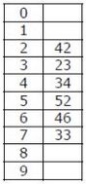
Q. A hash table of length 10 uses open addressing with hash function
h(k)=k mod 10, and linear probing. After inserting 6 values into an empty hash table, the table is as shown below.(GATE – 2014)
Which one of the following choices gives a possible order in which the key values could have been inserted in the table?
(A) 46, 42, 34, 52, 23, 33 (B) 34, 42, 23, 52, 33, 46 (C) 46, 34, 42, 23, 52, 33 (D) 42, 46, 33, 23, 34, 52

Slide 86
Ans. We will check whether sequence given in option A can lead to hash table given in question. Option A inserts 46, 42, 34, 52, 23, 33 as:
For key 46, h(46) is 46%10 = 6. Therefore, 46 is placed at 6th index in the hash table. For key 42, h(42) is 42%10 = 2. Therefore, 42 is placed at 2nd index in the hash table. For key 34, h(34) is 34%10 = 4. Therefore, 34 is placed at 4th index in the hash table. For key 52, h(52) is 52%10 = 2. However, index 2 is occupied with 42.
Therefore, 52 is placed at 3rd index in the hash table. But in given hash table, 52 is placed at 5th index.
Therefore, sequence in option A can’t generate hash table given in question.
In the similar way, we can check for other options as well which leads to answer as (C).

Slide 87
Drawback of linear probing
Primary clustering (forming group)
Now if we want to insert 39
Insert – 39 = [(39 % 13) + 0 ] % 13 = 0 (collision)
Insert – 39 = [(39 % 13) + 1 ] % 13 = 1 (collision)
Insert – 39 = [(39 % 13) + 2 ] % 13 = 2 (collision)
Insert – 39 = [(39 % 13) + 3 ] % 13 = 3 (collision)
Insert – 39 = [(39 % 13) + 4 ] % 13 = 4 (collision)
Insert – 39 = [(39 % 13) + 5 ] % 13 = 5 (collision)
Insert – 39 = [(39 % 13) + 6 ] % 13 = 6 (collision)
Insert – 39 = [(39 % 13) + 7 ] % 13 = 7
0 | 10
1 | 1
2 | 45
3 | 16
4 | 13
5 | 81
6 | 45
7
8
9 | 33
10 | 21
11 | 37
12

Slide 88
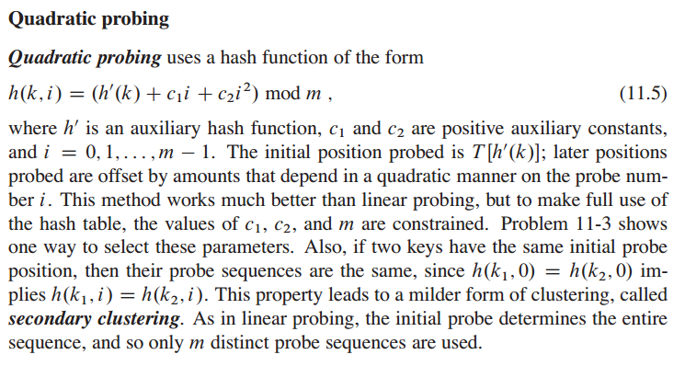
Quadratic probing

Slide 89

GATE Questions
Load factor (α) = n/m where n is the number of keys and m is the size of hash table.
Ans = 80.

Slide 90
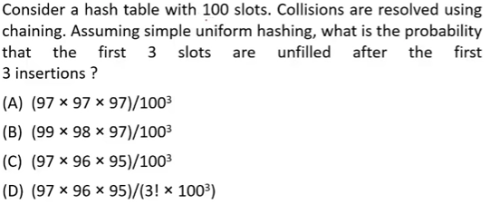
Ans - A

Slide 91
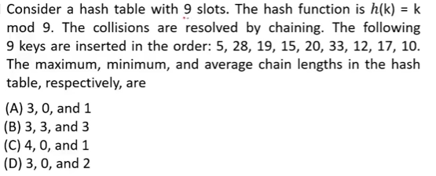
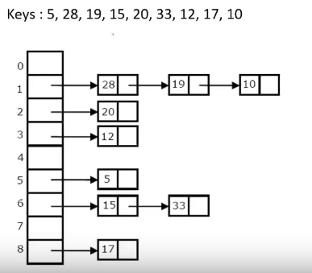
Min = 0
Max = 3
Avg = (0+3+1+1+0+1+2+0+1)/9 = 1

Slide 92
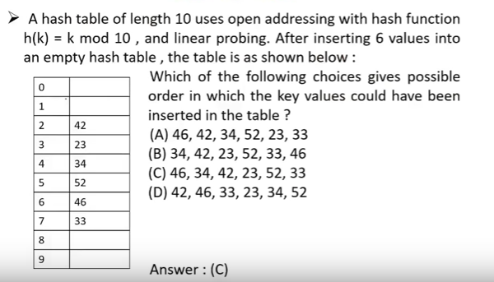

Slide 93
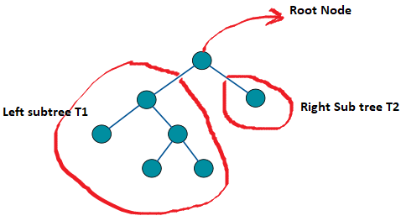
Binary Tree
A binary tree T is defined as a set of elements, called nodes, such that :
1. T is empty (called null tree or empty tree), or
2. T contains a distinguished node R, called root of T, and the remaining nodes of T
form an ordered pair of disjoint binary trees T1 and T2.
3. Maximum number of children of a node is 2, it can be 0,1, or 2.
4. A binary tree with n nodes has n-1 edges.
5. Any node has exactly one parent (except the root node).
6. The root node of a tree is the node with no parents.
7. There is at most one root node in a rooted tree.
8. A leaf node has no children.

Slide 94
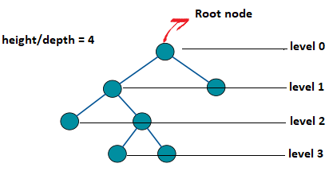
Binary tree..
9. Each node in the binary tree is assigned a level number starting from 0. The root R is at level 0 and every other node is assigned a level number which is 1 more than the level number of its parent.
10. The depth or height of tree T is turns out to be the 1 more than the largest level number of tree T.

Slide 95
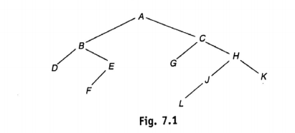
Binary tree
Any node N in binary tree T has either 0,1 or 2 successors.
D, F, G, L, K are terminal nodes (leaf nodes).

Slide 96
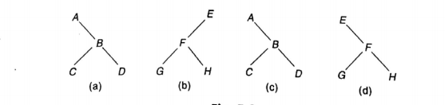
Binary tree
(a), (c), (d) are similar trees
(a) and (c) are copies.

Slide 97
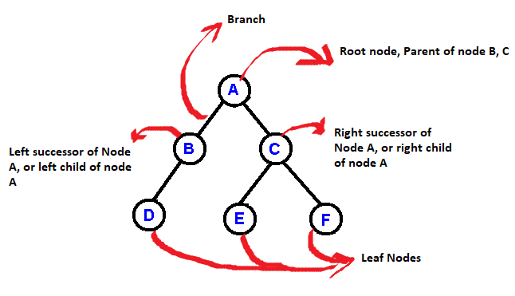
Terminology

Slide 98
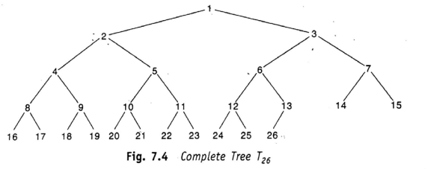
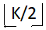
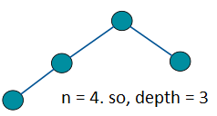
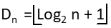
Complete binary tree
The tree T is said to be complete if all its levels, except Possibly the last , have maximum number of possible nodes.
Left child of node K = 2*K (eg. node 2 is having left child as node 4)
Right child of node K = 2*K + 1 (eg. node 2 is having right child as node 5)
Parent of node K = (floor value) (eg, node 2 is having parent node 1)
Depth D_{n} , where n is the total number of nodes in tree T.

Slide 99
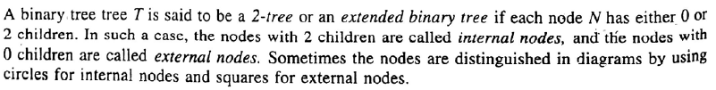
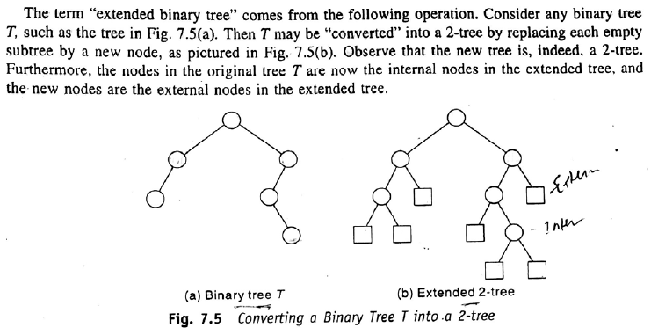
Extended Binary tree ( 2 – tree)

Slide 100
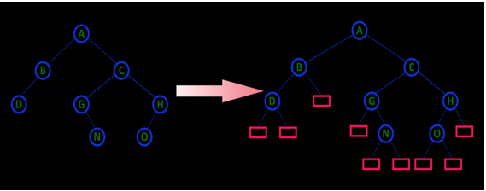

Slide 101
Threaded Binary tree
"A binary tree is threaded by making all right child pointers that would normally be null point to the inorder successor of the node (if it exists), and all left child pointers that would normally be null point to the inorder predecessor of the node.“[1]

Slide 102
Consider the linked representation of a binary tree T, approximately half of the entries in left pointer field and right pointer field contains NULL elements. This space occupied by NULL entries can be efficiently utilized to store some kind of valuable information. Specifically, we will replace certain NULL entries by special pointers which point to nodes higher in the tree. These special pointers are called Threads and binary tree with such pointers are called threaded tree.
Threads in a binary tree are represented by a dotted line. There are many ways to thread a binary tree these are—
The right NULL pointer of each leaf node can be replaced by a thread to the successor of that node under inorder traversal called a right thread, and the tree will called a right threaded tree or right threaded binary tree.
The left NULL pointer of each node can be replaced by a thread to the predecessor of that node under inorder traversal called left thread, and the tree will called a left threaded tree.
Both left and right NULL pointers can be used to point to predecessor and successor of that node respectively, under inorder traversal. Such a tree is called a fully threaded tree.
A threaded binary tree where only one thread is used is also known as one way threaded tree and where both threads are used is also known as two way threaded tree.

Slide 103
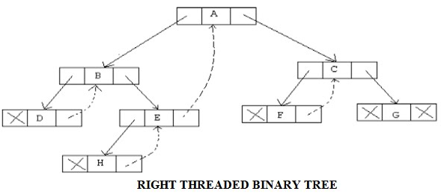
Right threaded tree or right threaded binary tree. (one-way)
Inorder = D B H E A F C G

Slide 104
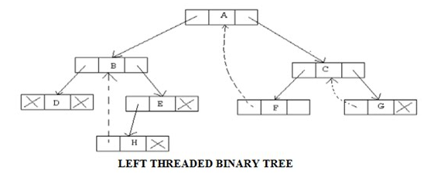
Left threaded tree or right threaded binary tree.
Inorder = D B H E A F C G

Slide 105
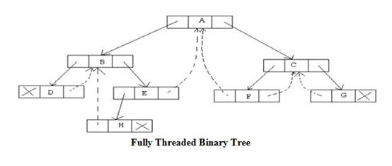
Two – way threaded binary tree.
Inorder = D B H E A F C G

Slide 106
Linked representation of the binary tree
INFO[K] contains the data at node N
LEFT[K] contain the location of left child of node N
RIGHT[K]contain the location of right child of node N
ROOT will contain the location of root R of tree T. If any subtree is empty, then the corresponding pointer will contain the null value; if the tree T itself is empty, then ROOT will contain the null value.

Slide 107
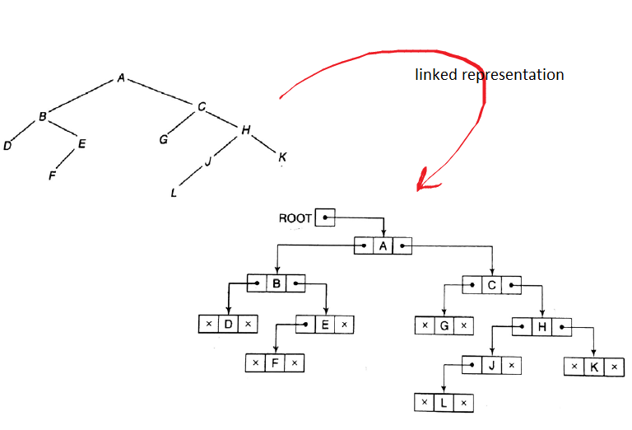
Linked representation of the binary tree…

Slide 108
Traversing of Binary tree
Three standard way of traversing the binary tree (preorder, inorder, postorder).
Preorder –
Traverse the root R
Traverse the left subtree of root R in preorder
Traverse the right subtree of root R in preorder
Inorder –
Traverse the left subtree of root R in inorder
Traverse the root R
Traverse the right subtree of root R in inorder
Postorder –
Traverse the left subtree of root R in preorder
Traverse the right subtree of root R in preorder
Traverse the root R

Slide 109
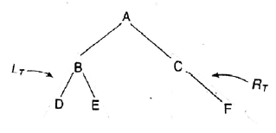
Traversing
Preorder – ABDECF
Inorder - DBEACF
Postorder - DEBFCA

Slide 110
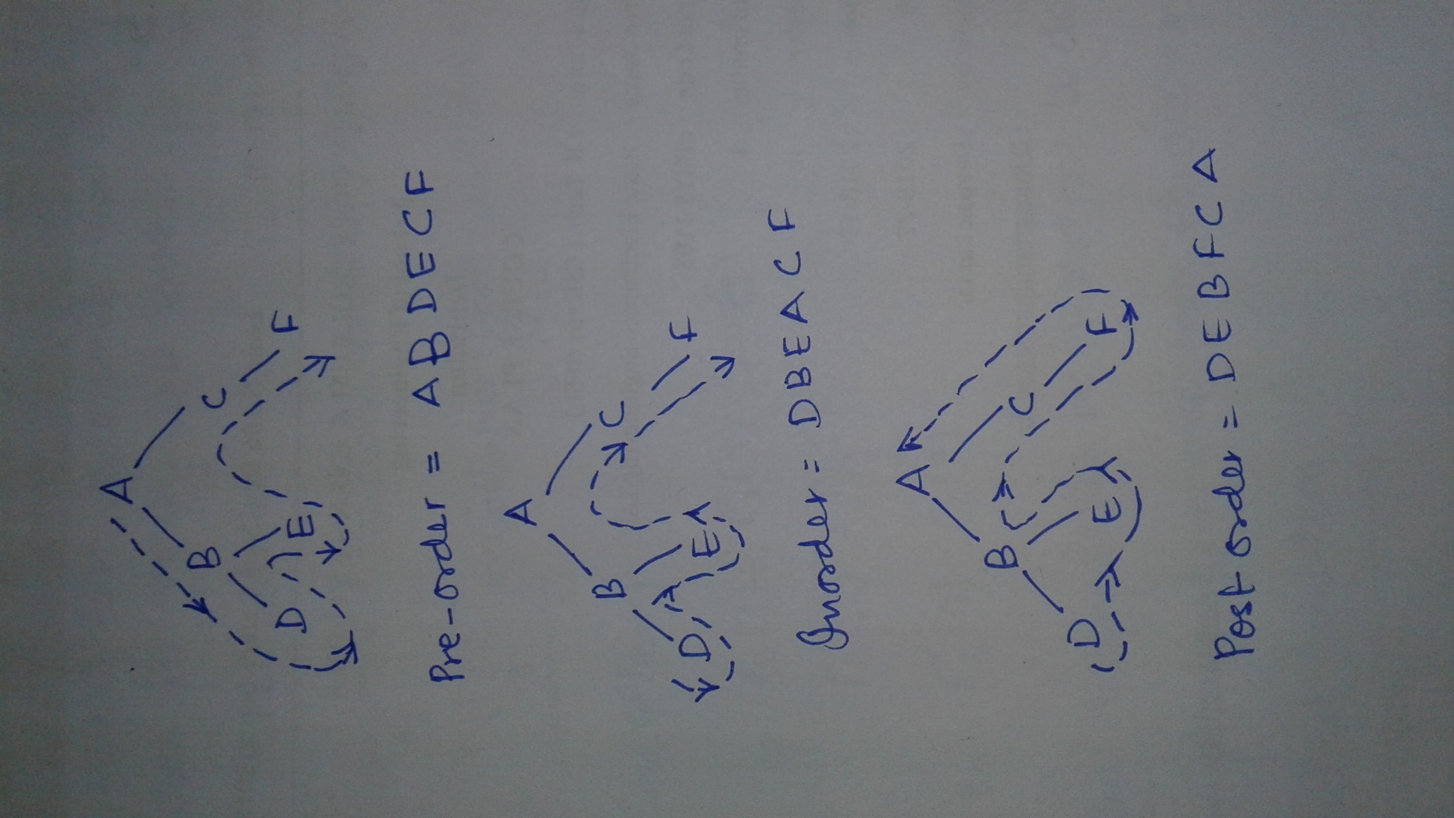

Slide 111
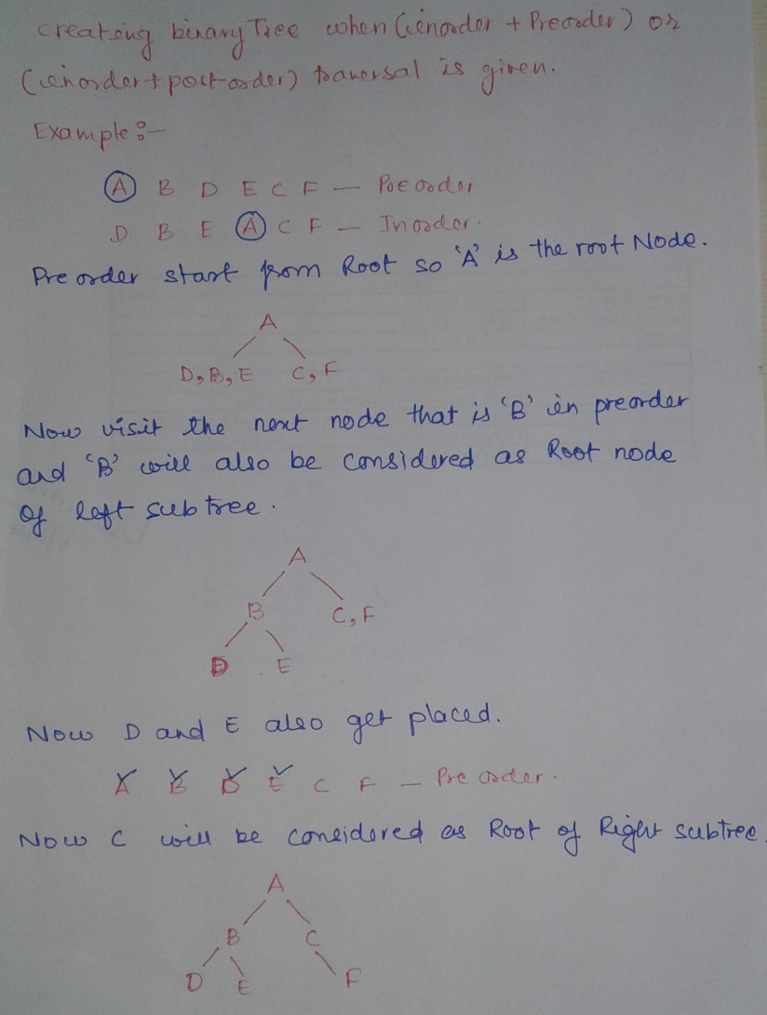

Slide 112
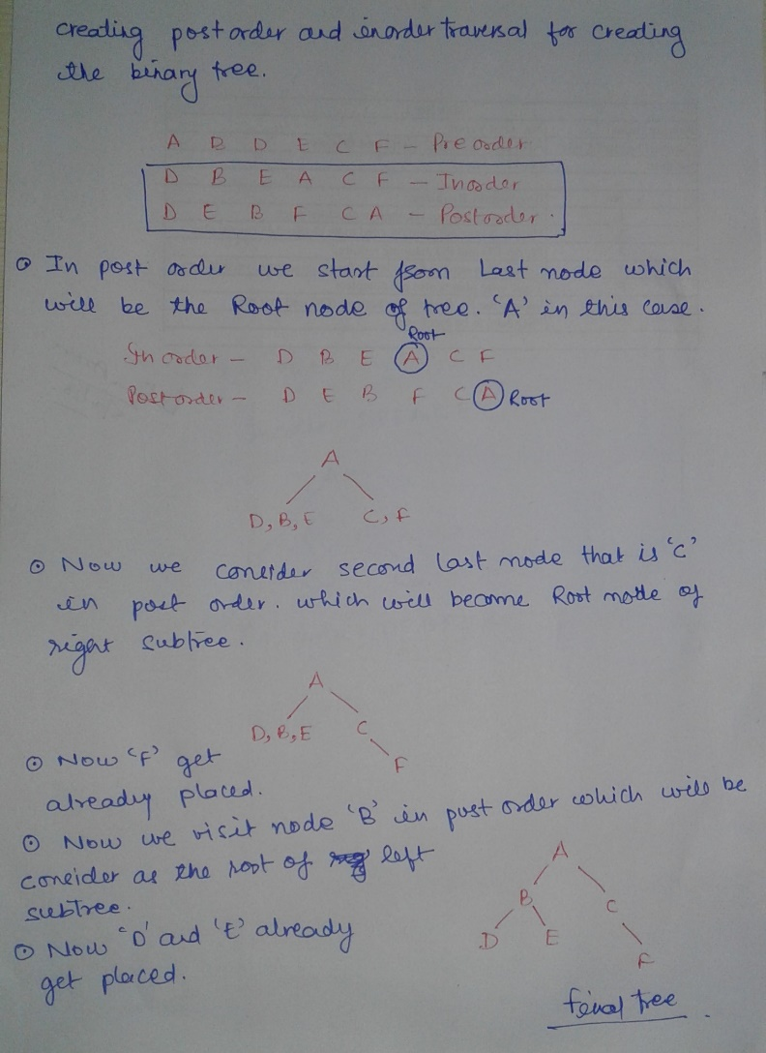

Slide 113
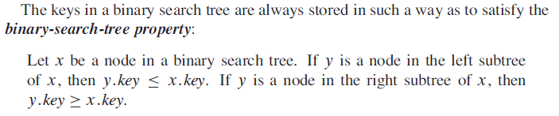
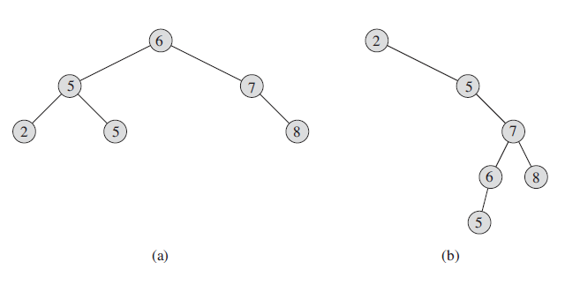
Binary Search Tree

Slide 114
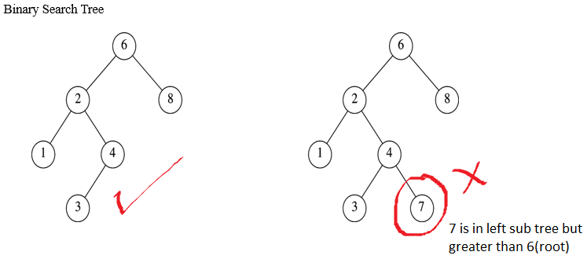
Which one is NOT a BST?

Slide 115
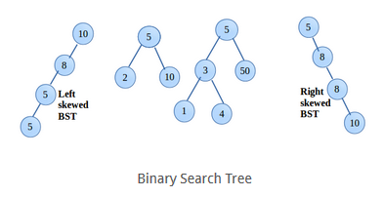
Skewed BST

Slide 116
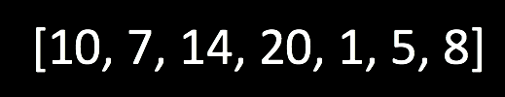
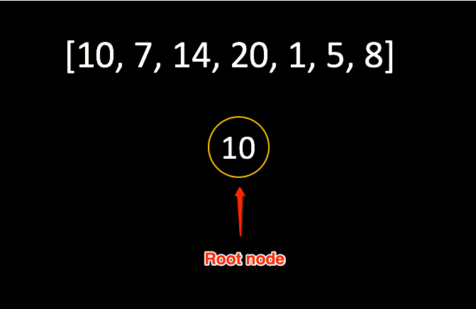

Slide 117
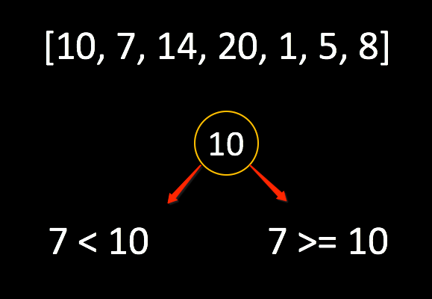
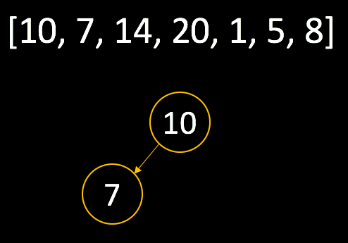

Slide 118



Slide 119



Slide 120


Slide 121

Example – 2 build a BST of the keys, 50, 80, 30, 20, 100, 40

Slide 122
Scenario
We have a Binary Search Tree
It can be empty
Or have some elements in it already
We want to add an element to it
Inserting/adding involves 2 steps:
Find the correct location
Do the steps to add a new node
Must maintain “search” structure

Slide 123

Searching
Searching 40 in binary search tree

Slide 124
Finding the Correct Location
Start with this tree
12
3
41
98
7

Slide 125
Finding the Correct Location
Where would
4 be added?
12
3
41
7
98

Slide 126
Finding the Correct Location
4
To the top doesn’t work
12
3
41
98
7

Slide 127
Finding the Correct Location
12
4
41
3
98
In the middle doesn’t work
7

Slide 128
Finding the Correct Location
12
3
41
7
98
4
At the bottom DOES work!

Slide 129
Finding the Correct Location
Must maintain “search” structure
Everything to left is less than current
Everything to right is greater than current
Adding at the “bottom” guarantees we keep search structure.
We’ll recurse to get to the “bottom” (i.e. when current = nil)

Slide 130
Finding the Correct Location
if (current = nil)
DO “ADD NODE” WORK HERE
elseif (current^.data > value_to_add) then
// recurse left
Insert(current^.left, value_to_add)
else
// recurse right
Insert(current^.right, value_to_add)
endif

Slide 131
Head Ptr to a root Node
head <- NIL
Insert(head, 42)

Slide 132
Head iot Ptr toa Node
head <- NIL
Insert(head, 42)
head

Slide 133
Head iot Ptr toa Node
head <- NIL
Insert(head, 42)
head

Slide 134
Head iot Ptr toa Node
head <- NIL
Insert(head, 42)
head

Slide 135
Head iot Ptr toa Node
head <- NIL
Insert(head, 42)
head
procedure Insert(
cur iot in/out Ptr toa Node,
data_in iot in num)
if(cur = NIL) then
cur <- new(Node)
cur^.data <- data_in
cur^.left <- NIL
cur^.right <- NIL
elseif(cur^.data > data_in)
Insert(cur^.left, data_in)
else
Insert(cur^.right, data_in)
endif
endprocedure // Insert

Slide 136
Head iot Ptr toa Node
head <- NIL
Insert(head, 42)
head
procedure Insert(
cur iot in/out Ptr toa Node,
data_in iot in num)
if(cur = NIL) then
cur <- new(Node)
cur^.data <- data_in
cur^.left <- NIL
cur^.right <- NIL
elseif(cur^.data > data_in)
Insert(cur^.left, data_in)
else
Insert(cur^.right, data_in)
endif
endprocedure // Insert

Slide 137
Head iot Ptr toa Node
head <- NIL
Insert(head, 42)
head
procedure Insert(
cur iot in/out Ptr toa Node,
data_in iot in num)
if(cur = NIL) then
cur <- new(Node)
cur^.data <- data_in
cur^.left <- NIL
cur^.right <- NIL
elseif(cur^.data > data_in)
Insert(cur^.left, data_in)
else
Insert(cur^.right, data_in)
endif
endprocedure // Insert
42

Slide 138
Head iot Ptr toa Node
head <- NIL
Insert(head, 42)
head
procedure Insert(
cur iot in/out Ptr toa Node,
data_in iot in num)
if(cur = NIL) then
cur <- new(Node)
cur^.data <- data_in
cur^.left <- NIL
cur^.right <- NIL
elseif(cur^.data > data_in)
Insert(cur^.left, data_in)
else
Insert(cur^.right, data_in)
endif
endprocedure // Insert
42

Slide 139
Head iot Ptr toa Node
head <- NIL
Insert(head, 42)
head
procedure Insert(
cur iot in/out Ptr toa Node,
data_in iot in num)
if(cur = NIL) then
cur <- new(Node)
cur^.data <- data_in
cur^.left <- NIL
cur^.right <- NIL
elseif(cur^.data > data_in)
Insert(cur^.left, data_in)
else
Insert(cur^.right, data_in)
endif
endprocedure // Insert
42

Slide 140
Head iot Ptr toa Node
head <- NIL
Insert(head, 42)
head
procedure Insert(
cur iot in/out Ptr toa Node,
data_in iot in num)
if(cur = NIL) then
cur <- new(Node)
cur^.data <- data_in
cur^.left <- NIL
cur^.right <- NIL
elseif(cur^.data > data_in)
Insert(cur^.left, data_in)
else
Insert(cur^.right, data_in)
endif
endprocedure // Insert
42

Slide 141
.
.
Insert(head, 23)
Insert(head, 35)
Insert(head, 47)
.
.
head
42

Slide 142
.
.
Insert(head, 23)
Insert(head, 35)
Insert(head, 47)
.
.
head
procedure Insert(
cur iot in/out Ptr toa Node,
data_in iot in num)
if(cur = NIL) then
cur <- new(Node)
cur^.data <- data_in
cur^.left <- NIL
cur^.right <- NIL
elseif(cur^.data > data_in)
Insert(cur^.left, data_in)
else
Insert(cur^.right, data_in)
endif
endprocedure // Insert
42
data_in = 23

Slide 143
.
.
Insert(head, 23)
Insert(head, 35)
Insert(head, 47)
.
.
head
procedure Insert(
cur iot in/out Ptr toa Node,
data_in iot in num)
if(cur = NIL) then
cur <- new(Node)
cur^.data <- data_in
cur^.left <- NIL
cur^.right <- NIL
elseif(cur^.data > data_in)
Insert(cur^.left, data_in)
else
Insert(cur^.right, data_in)
endif
endprocedure // Insert
42
data_in = 23

Slide 144
.
.
Insert(head, 23)
Insert(head, 35)
Insert(head, 47)
.
.
head
procedure Insert(
cur iot in/out Ptr toa Node,
data_in iot in num)
if(cur = NIL) then
cur <- new(Node)
cur^.data <- data_in
cur^.left <- NIL
cur^.right <- NIL
elseif(cur^.data > data_in)
Insert(cur^.left, data_in)
else
Insert(cur^.right, data_in)
endif
endprocedure // Insert
42
data_in = 23

Slide 145
.
.
Insert(head, 23)
Insert(head, 35)
Insert(head, 47)
.
.
head
procedure Insert(
cur iot in/out Ptr toa Node,
data_in iot in num)
if(cur = NIL) then
cur <- new(Node)
cur^.data <- data_in
cur^.left <- NIL
cur^.right <- NIL
elseif(cur^.data > data_in)
Insert(cur^.left, data_in)
else
Insert(cur^.right, data_in)
endif
endprocedure // Insert
procedure Insert(
cur iot in/out Ptr toa Node,
data_in iot in num)
if(cur = NIL) then
cur <- new(Node)
cur^.data <- data_in
cur^.left <- NIL
cur^.right <- NIL
elseif(cur^.data > data_in)
Insert(cur^.left, data_in)
else
Insert(cur^.right, data_in)
endif
endprocedure // Insert
42
data_in = 23

Slide 146
.
.
Insert(head, 23)
Insert(head, 35)
Insert(head, 47)
.
.
head
procedure Insert(
cur iot in/out Ptr toa Node,
data_in iot in num)
if(cur = NIL) then
cur <- new(Node)
cur^.data <- data_in
cur^.left <- NIL
cur^.right <- NIL
elseif(cur^.data > data_in)
Insert(cur^.left, data_in)
else
Insert(cur^.right, data_in)
endif
endprocedure // Insert
procedure Insert(
cur iot in/out Ptr toa Node,
data_in iot in num)
if(cur = NIL) then
cur <- new(Node)
cur^.data <- data_in
cur^.left <- NIL
cur^.right <- NIL
elseif(cur^.data > data_in)
Insert(cur^.left, data_in)
else
Insert(cur^.right, data_in)
endif
endprocedure // Insert
42
data_in = 23

Slide 147
.
.
Insert(head, 23)
Insert(head, 35)
Insert(head, 47)
.
.
head
procedure Insert(
cur iot in/out Ptr toa Node,
data_in iot in num)
if(cur = NIL) then
cur <- new(Node)
cur^.data <- data_in
cur^.left <- NIL
cur^.right <- NIL
elseif(cur^.data > data_in)
Insert(cur^.left, data_in)
else
Insert(cur^.right, data_in)
endif
endprocedure // Insert
procedure Insert(
cur iot in/out Ptr toa Node,
data_in iot in num)
if(cur = NIL) then
cur <- new(Node)
cur^.data <- data_in
cur^.left <- NIL
cur^.right <- NIL
elseif(cur^.data > data_in)
Insert(cur^.left, data_in)
else
Insert(cur^.right, data_in)
endif
endprocedure // Insert
42
23
data_in = 23

Slide 148
.
.
Insert(head, 23)
Insert(head, 35)
Insert(head, 47)
.
.
head
procedure Insert(
cur iot in/out Ptr toa Node,
data_in iot in num)
if(cur = NIL) then
cur <- new(Node)
cur^.data <- data_in
cur^.left <- NIL
cur^.right <- NIL
elseif(cur^.data > data_in)
Insert(cur^.left, data_in)
else
Insert(cur^.right, data_in)
endif
endprocedure // Insert
procedure Insert(
cur iot in/out Ptr toa Node,
data_in iot in num)
if(cur = NIL) then
cur <- new(Node)
cur^.data <- data_in
cur^.left <- NIL
cur^.right <- NIL
elseif(cur^.data > data_in)
Insert(cur^.left, data_in)
else
Insert(cur^.right, data_in)
endif
endprocedure // Insert
42
23
data_in = 23

Slide 149
.
.
Insert(head, 23)
Insert(head, 35)
Insert(head, 47)
.
.
head
procedure Insert(
cur iot in/out Ptr toa Node,
data_in iot in num)
if(cur = NIL) then
cur <- new(Node)
cur^.data <- data_in
cur^.left <- NIL
cur^.right <- NIL
elseif(cur^.data > data_in)
Insert(cur^.left, data_in)
else
Insert(cur^.right, data_in)
endif
endprocedure // Insert
procedure Insert(
cur iot in/out Ptr toa Node,
data_in iot in num)
if(cur = NIL) then
cur <- new(Node)
cur^.data <- data_in
cur^.left <- NIL
cur^.right <- NIL
elseif(cur^.data > data_in)
Insert(cur^.left, data_in)
else
Insert(cur^.right, data_in)
endif
endprocedure // Insert
42
23
data_in = 23

Slide 150
.
.
Insert(head, 23)
Insert(head, 35)
Insert(head, 47)
.
.
head
procedure Insert(
cur iot in/out Ptr toa Node,
data_in iot in num)
if(cur = NIL) then
cur <- new(Node)
cur^.data <- data_in
cur^.left <- NIL
cur^.right <- NIL
elseif(cur^.data > data_in)
Insert(cur^.left, data_in)
else
Insert(cur^.right, data_in)
endif
endprocedure // Insert
procedure Insert(
cur iot in/out Ptr toa Node,
data_in iot in num)
if(cur = NIL) then
cur <- new(Node)
cur^.data <- data_in
cur^.left <- NIL
cur^.right <- NIL
elseif(cur^.data > data_in)
Insert(cur^.left, data_in)
else
Insert(cur^.right, data_in)
endif
endprocedure // Insert
42
23
data_in = 23

Slide 151
.
.
Insert(head, 23)
Insert(head, 35)
Insert(head, 47)
.
.
head
procedure Insert(
cur iot in/out Ptr toa Node,
data_in iot in num)
if(cur = NIL) then
cur <- new(Node)
cur^.data <- data_in
cur^.left <- NIL
cur^.right <- NIL
elseif(cur^.data > data_in)
Insert(cur^.left, data_in)
else
Insert(cur^.right, data_in)
endif
endprocedure // Insert
42
23
data_in = 23

Slide 152
.
.
Insert(head, 23)
Insert(head, 35)
Insert(head, 47)
.
.
head
42
23

Slide 153
.
.
Insert(head, 23)
Insert(head, 35)
Insert(head, 47)
.
.
head
procedure Insert(
cur iot in/out Ptr toa Node,
data_in iot in num)
if(cur = NIL) then
cur <- new(Node)
cur^.data <- data_in
cur^.left <- NIL
cur^.right <- NIL
elseif(cur^.data > data_in)
Insert(cur^.left, data_in)
else
Insert(cur^.right, data_in)
endif
endprocedure // Insert
42
23
data_in = 35

Slide 154
.
.
Insert(head, 23)
Insert(head, 35)
Insert(head, 47)
.
.
head
procedure Insert(
cur iot in/out Ptr toa Node,
data_in iot in num)
if(cur = NIL) then
cur <- new(Node)
cur^.data <- data_in
cur^.left <- NIL
cur^.right <- NIL
elseif(cur^.data > data_in)
Insert(cur^.left, data_in)
else
Insert(cur^.right, data_in)
endif
endprocedure // Insert
42
23
data_in = 35

Slide 155
.
.
Insert(head, 23)
Insert(head, 35)
Insert(head, 47)
.
.
head
procedure Insert(
cur iot in/out Ptr toa Node,
data_in iot in num)
if(cur = NIL) then
cur <- new(Node)
cur^.data <- data_in
cur^.left <- NIL
cur^.right <- NIL
elseif(cur^.data > data_in)
Insert(cur^.left, data_in)
else
Insert(cur^.right, data_in)
endif
endprocedure // Insert
42
23
data_in = 35

Slide 156
.
.
Insert(head, 23)
Insert(head, 35)
Insert(head, 47)
.
.
head
procedure Insert(
cur iot in/out Ptr toa Node,
data_in iot in num)
if(cur = NIL) then
cur <- new(Node)
cur^.data <- data_in
cur^.left <- NIL
cur^.right <- NIL
elseif(cur^.data > data_in)
Insert(cur^.left, data_in)
else
Insert(cur^.right, data_in)
endif
endprocedure // Insert
procedure Insert(
cur iot in/out Ptr toa Node,
data_in iot in num)
if(cur = NIL) then
cur <- new(Node)
cur^.data <- data_in
cur^.left <- NIL
cur^.right <- NIL
elseif(cur^.data > data_in)
Insert(cur^.left, data_in)
else
Insert(cur^.right, data_in)
endif
endprocedure // Insert
42
23
data_in = 35

Slide 157
.
.
Insert(head, 23)
Insert(head, 35)
Insert(head, 47)
.
.
head
procedure Insert(
cur iot in/out Ptr toa Node,
data_in iot in num)
if(cur = NIL) then
cur <- new(Node)
cur^.data <- data_in
cur^.left <- NIL
cur^.right <- NIL
elseif(cur^.data > data_in)
Insert(cur^.left, data_in)
else
Insert(cur^.right, data_in)
endif
endprocedure // Insert
procedure Insert(
cur iot in/out Ptr toa Node,
data_in iot in num)
if(cur = NIL) then
cur <- new(Node)
cur^.data <- data_in
cur^.left <- NIL
cur^.right <- NIL
elseif(cur^.data > data_in)
Insert(cur^.left, data_in)
else
Insert(cur^.right, data_in)
endif
endprocedure // Insert
42
23
data_in = 35

Slide 158
.
.
Insert(head, 23)
Insert(head, 35)
Insert(head, 47)
.
.
head
procedure Insert(
cur iot in/out Ptr toa Node,
data_in iot in num)
if(cur = NIL) then
cur <- new(Node)
cur^.data <- data_in
cur^.left <- NIL
cur^.right <- NIL
elseif(cur^.data > data_in)
Insert(cur^.left, data_in)
else
Insert(cur^.right, data_in)
endif
endprocedure // Insert
procedure Insert(
cur iot in/out Ptr toa Node,
data_in iot in num)
if(cur = NIL) then
cur <- new(Node)
cur^.data <- data_in
cur^.left <- NIL
cur^.right <- NIL
elseif(cur^.data > data_in)
Insert(cur^.left, data_in)
else
Insert(cur^.right, data_in)
endif
endprocedure // Insert
42
23
data_in = 35

Slide 159
.
.
Insert(head, 23)
Insert(head, 35)
Insert(head, 47)
.
.
head
procedure Insert(
cur iot in/out Ptr toa Node,
data_in iot in num)
if(cur = NIL) then
cur <- new(Node)
cur^.data <- data_in
cur^.left <- NIL
cur^.right <- NIL
elseif(cur^.data > data_in)
Insert(cur^.left, data_in)
else
Insert(cur^.right, data_in)
endif
endprocedure // Insert
procedure Insert(
cur iot in/out Ptr toa Node,
data_in iot in num)
if(cur = NIL) then
cur <- new(Node)
cur^.data <- data_in
cur^.left <- NIL
cur^.right <- NIL
elseif(cur^.data > data_in)
Insert(cur^.left, data_in)
else
Insert(cur^.right, data_in)
endif
endprocedure // Insert
procedure Insert(
cur iot in/out Ptr toa Node,
data_in iot in num)
if(cur = NIL) then
cur <- new(Node)
cur^.data <- data_in
cur^.left <- NIL
cur^.right <- NIL
elseif(cur^.data > data_in)
Insert(cur^.left, data_in)
else
Insert(cur^.right, data_in)
endif
endprocedure // Insert
42
23
data_in = 35

Slide 160
.
.
Insert(head, 23)
Insert(head, 35)
Insert(head, 47)
.
.
head
procedure Insert(
cur iot in/out Ptr toa Node,
data_in iot in num)
if(cur = NIL) then
cur <- new(Node)
cur^.data <- data_in
cur^.left <- NIL
cur^.right <- NIL
elseif(cur^.data > data_in)
Insert(cur^.left, data_in)
else
Insert(cur^.right, data_in)
endif
endprocedure // Insert
procedure Insert(
cur iot in/out Ptr toa Node,
data_in iot in num)
if(cur = NIL) then
cur <- new(Node)
cur^.data <- data_in
cur^.left <- NIL
cur^.right <- NIL
elseif(cur^.data > data_in)
Insert(cur^.left, data_in)
else
Insert(cur^.right, data_in)
endif
endprocedure // Insert
procedure Insert(
cur iot in/out Ptr toa Node,
data_in iot in num)
if(cur = NIL) then
cur <- new(Node)
cur^.data <- data_in
cur^.left <- NIL
cur^.right <- NIL
elseif(cur^.data > data_in)
Insert(cur^.left, data_in)
else
Insert(cur^.right, data_in)
endif
endprocedure // Insert
42
23
data_in = 35

Slide 161
.
.
Insert(head, 23)
Insert(head, 35)
Insert(head, 47)
.
.
head
procedure Insert(
cur iot in/out Ptr toa Node,
data_in iot in num)
if(cur = NIL) then
cur <- new(Node)
cur^.data <- data_in
cur^.left <- NIL
cur^.right <- NIL
elseif(cur^.data > data_in)
Insert(cur^.left, data_in)
else
Insert(cur^.right, data_in)
endif
endprocedure // Insert
procedure Insert(
cur iot in/out Ptr toa Node,
data_in iot in num)
if(cur = NIL) then
cur <- new(Node)
cur^.data <- data_in
cur^.left <- NIL
cur^.right <- NIL
elseif(cur^.data > data_in)
Insert(cur^.left, data_in)
else
Insert(cur^.right, data_in)
endif
endprocedure // Insert
procedure Insert(
cur iot in/out Ptr toa Node,
data_in iot in num)
if(cur = NIL) then
cur <- new(Node)
cur^.data <- data_in
cur^.left <- NIL
cur^.right <- NIL
elseif(cur^.data > data_in)
Insert(cur^.left, data_in)
else
Insert(cur^.right, data_in)
endif
endprocedure // Insert
42
23
35
data_in = 35

Slide 162
.
.
Insert(head, 23)
Insert(head, 35)
Insert(head, 47)
.
.
head
procedure Insert(
cur iot in/out Ptr toa Node,
data_in iot in num)
if(cur = NIL) then
cur <- new(Node)
cur^.data <- data_in
cur^.left <- NIL
cur^.right <- NIL
elseif(cur^.data > data_in)
Insert(cur^.left, data_in)
else
Insert(cur^.right, data_in)
endif
endprocedure // Insert
procedure Insert(
cur iot in/out Ptr toa Node,
data_in iot in num)
if(cur = NIL) then
cur <- new(Node)
cur^.data <- data_in
cur^.left <- NIL
cur^.right <- NIL
elseif(cur^.data > data_in)
Insert(cur^.left, data_in)
else
Insert(cur^.right, data_in)
endif
endprocedure // Insert
procedure Insert(
cur iot in/out Ptr toa Node,
data_in iot in num)
if(cur = NIL) then
cur <- new(Node)
cur^.data <- data_in
cur^.left <- NIL
cur^.right <- NIL
elseif(cur^.data > data_in)
Insert(cur^.left, data_in)
else
Insert(cur^.right, data_in)
endif
endprocedure // Insert
42
23
35
data_in = 35

Slide 163
.
.
Insert(head, 23)
Insert(head, 35)
Insert(head, 47)
.
.
head
procedure Insert(
cur iot in/out Ptr toa Node,
data_in iot in num)
if(cur = NIL) then
cur <- new(Node)
cur^.data <- data_in
cur^.left <- NIL
cur^.right <- NIL
elseif(cur^.data > data_in)
Insert(cur^.left, data_in)
else
Insert(cur^.right, data_in)
endif
endprocedure // Insert
procedure Insert(
cur iot in/out Ptr toa Node,
data_in iot in num)
if(cur = NIL) then
cur <- new(Node)
cur^.data <- data_in
cur^.left <- NIL
cur^.right <- NIL
elseif(cur^.data > data_in)
Insert(cur^.left, data_in)
else
Insert(cur^.right, data_in)
endif
endprocedure // Insert
procedure Insert(
cur iot in/out Ptr toa Node,
data_in iot in num)
if(cur = NIL) then
cur <- new(Node)
cur^.data <- data_in
cur^.left <- NIL
cur^.right <- NIL
elseif(cur^.data > data_in)
Insert(cur^.left, data_in)
else
Insert(cur^.right, data_in)
endif
endprocedure // Insert
42
23
35
data_in = 35

Slide 164
.
.
Insert(head, 23)
Insert(head, 35)
Insert(head, 47)
.
.
head
procedure Insert(
cur iot in/out Ptr toa Node,
data_in iot in num)
if(cur = NIL) then
cur <- new(Node)
cur^.data <- data_in
cur^.left <- NIL
cur^.right <- NIL
elseif(cur^.data > data_in)
Insert(cur^.left, data_in)
else
Insert(cur^.right, data_in)
endif
endprocedure // Insert
procedure Insert(
cur iot in/out Ptr toa Node,
data_in iot in num)
if(cur = NIL) then
cur <- new(Node)
cur^.data <- data_in
cur^.left <- NIL
cur^.right <- NIL
elseif(cur^.data > data_in)
Insert(cur^.left, data_in)
else
Insert(cur^.right, data_in)
endif
endprocedure // Insert
procedure Insert(
cur iot in/out Ptr toa Node,
data_in iot in num)
if(cur = NIL) then
cur <- new(Node)
cur^.data <- data_in
cur^.left <- NIL
cur^.right <- NIL
elseif(cur^.data > data_in)
Insert(cur^.left, data_in)
else
Insert(cur^.right, data_in)
endif
endprocedure // Insert
42
23
35
data_in = 35

Slide 165
.
.
Insert(head, 23)
Insert(head, 35)
Insert(head, 47)
.
.
head
procedure Insert(
cur iot in/out Ptr toa Node,
data_in iot in num)
if(cur = NIL) then
cur <- new(Node)
cur^.data <- data_in
cur^.left <- NIL
cur^.right <- NIL
elseif(cur^.data > data_in)
Insert(cur^.left, data_in)
else
Insert(cur^.right, data_in)
endif
endprocedure // Insert
procedure Insert(
cur iot in/out Ptr toa Node,
data_in iot in num)
if(cur = NIL) then
cur <- new(Node)
cur^.data <- data_in
cur^.left <- NIL
cur^.right <- NIL
elseif(cur^.data > data_in)
Insert(cur^.left, data_in)
else
Insert(cur^.right, data_in)
endif
endprocedure // Insert
42
23
35
data_in = 35

Slide 166
.
.
Insert(head, 23)
Insert(head, 35)
Insert(head, 47)
.
.
head
procedure Insert(
cur iot in/out Ptr toa Node,
data_in iot in num)
if(cur = NIL) then
cur <- new(Node)
cur^.data <- data_in
cur^.left <- NIL
cur^.right <- NIL
elseif(cur^.data > data_in)
Insert(cur^.left, data_in)
else
Insert(cur^.right, data_in)
endif
endprocedure // Insert
42
23
35
data_in = 35

Slide 167
.
.
Insert(head, 23)
Insert(head, 35)
Insert(head, 47)
.
.
head
42
23
35

Slide 168
Continue?
yes...
I’ve had enough!

Slide 169
.
.
Insert(head, 23)
Insert(head, 35)
Insert(head, 47)
.
.
head
procedure Insert(
cur iot in/out Ptr toa Node,
data_in iot in num)
if(cur = NIL) then
cur <- new(Node)
cur^.data <- data_in
cur^.left <- NIL
cur^.right <- NIL
elseif(cur^.data > data_in)
Insert(cur^.left, data_in)
else
Insert(cur^.right, data_in)
endif
endprocedure // Insert
42
23
35
data_in = 47

Slide 170
.
.
Insert(head, 23)
Insert(head, 35)
Insert(head, 47)
.
.
head
procedure Insert(
cur iot in/out Ptr toa Node,
data_in iot in num)
if(cur = NIL) then
cur <- new(Node)
cur^.data <- data_in
cur^.left <- NIL
cur^.right <- NIL
elseif(cur^.data > data_in)
Insert(cur^.left, data_in)
else
Insert(cur^.right, data_in)
endif
endprocedure // Insert
42
23
35
data_in = 47

Slide 171
.
.
Insert(head, 23)
Insert(head, 35)
Insert(head, 47)
.
.
head
procedure Insert(
cur iot in/out Ptr toa Node,
data_in iot in num)
if(cur = NIL) then
cur <- new(Node)
cur^.data <- data_in
cur^.left <- NIL
cur^.right <- NIL
elseif(cur^.data > data_in)
Insert(cur^.left, data_in)
else
Insert(cur^.right, data_in)
endif
endprocedure // Insert
42
23
35
data_in = 47

Slide 172
.
.
Insert(head, 23)
Insert(head, 35)
Insert(head, 47)
.
.
head
procedure Insert(
cur iot in/out Ptr toa Node,
data_in iot in num)
if(cur = NIL) then
cur <- new(Node)
cur^.data <- data_in
cur^.left <- NIL
cur^.right <- NIL
elseif(cur^.data > data_in)
Insert(cur^.left, data_in)
else
Insert(cur^.right, data_in)
endif
endprocedure // Insert
procedure Insert(
cur iot in/out Ptr toa Node,
data_in iot in num)
if(cur = NIL) then
cur <- new(Node)
cur^.data <- data_in
cur^.left <- NIL
cur^.right <- NIL
elseif(cur^.data > data_in)
Insert(cur^.left, data_in)
else
Insert(cur^.right, data_in)
endif
endprocedure // Insert
42
23
35
data_in = 47

Slide 173
.
.
Insert(head, 23)
Insert(head, 35)
Insert(head, 47)
.
.
head
procedure Insert(
cur iot in/out Ptr toa Node,
data_in iot in num)
if(cur = NIL) then
cur <- new(Node)
cur^.data <- data_in
cur^.left <- NIL
cur^.right <- NIL
elseif(cur^.data > data_in)
Insert(cur^.left, data_in)
else
Insert(cur^.right, data_in)
endif
endprocedure // Insert
procedure Insert(
cur iot in/out Ptr toa Node,
data_in iot in num)
if(cur = NIL) then
cur <- new(Node)
cur^.data <- data_in
cur^.left <- NIL
cur^.right <- NIL
elseif(cur^.data > data_in)
Insert(cur^.left, data_in)
else
Insert(cur^.right, data_in)
endif
endprocedure // Insert
42
23
35
data_in = 47

Slide 174
.
.
Insert(head, 23)
Insert(head, 35)
Insert(head, 47)
.
.
head
procedure Insert(
cur iot in/out Ptr toa Node,
data_in iot in num)
if(cur = NIL) then
cur <- new(Node)
cur^.data <- data_in
cur^.left <- NIL
cur^.right <- NIL
elseif(cur^.data > data_in)
Insert(cur^.left, data_in)
else
Insert(cur^.right, data_in)
endif
endprocedure // Insert
procedure Insert(
cur iot in/out Ptr toa Node,
data_in iot in num)
if(cur = NIL) then
cur <- new(Node)
cur^.data <- data_in
cur^.left <- NIL
cur^.right <- NIL
elseif(cur^.data > data_in)
Insert(cur^.left, data_in)
else
Insert(cur^.right, data_in)
endif
endprocedure // Insert
42
23
47
35
data_in = 47

Slide 175
.
.
Insert(head, 23)
Insert(head, 35)
Insert(head, 47)
.
.
head
procedure Insert(
cur iot in/out Ptr toa Node,
data_in iot in num)
if(cur = NIL) then
cur <- new(Node)
cur^.data <- data_in
cur^.left <- NIL
cur^.right <- NIL
elseif(cur^.data > data_in)
Insert(cur^.left, data_in)
else
Insert(cur^.right, data_in)
endif
endprocedure // Insert
procedure Insert(
cur iot in/out Ptr toa Node,
data_in iot in num)
if(cur = NIL) then
cur <- new(Node)
cur^.data <- data_in
cur^.left <- NIL
cur^.right <- NIL
elseif(cur^.data > data_in)
Insert(cur^.left, data_in)
else
Insert(cur^.right, data_in)
endif
endprocedure // Insert
42
23
47
35
data_in = 47

Slide 176
.
.
Insert(head, 23)
Insert(head, 35)
Insert(head, 47)
.
.
head
procedure Insert(
cur iot in/out Ptr toa Node,
data_in iot in num)
if(cur = NIL) then
cur <- new(Node)
cur^.data <- data_in
cur^.left <- NIL
cur^.right <- NIL
elseif(cur^.data > data_in)
Insert(cur^.left, data_in)
else
Insert(cur^.right, data_in)
endif
endprocedure // Insert
procedure Insert(
cur iot in/out Ptr toa Node,
data_in iot in num)
if(cur = NIL) then
cur <- new(Node)
cur^.data <- data_in
cur^.left <- NIL
cur^.right <- NIL
elseif(cur^.data > data_in)
Insert(cur^.left, data_in)
else
Insert(cur^.right, data_in)
endif
endprocedure // Insert
42
23
47
35
data_in = 47

Slide 177
.
.
Insert(head, 23)
Insert(head, 35)
Insert(head, 47)
.
.
head
procedure Insert(
cur iot in/out Ptr toa Node,
data_in iot in num)
if(cur = NIL) then
cur <- new(Node)
cur^.data <- data_in
cur^.left <- NIL
cur^.right <- NIL
elseif(cur^.data > data_in)
Insert(cur^.left, data_in)
else
Insert(cur^.right, data_in)
endif
endprocedure // Insert
procedure Insert(
cur iot in/out Ptr toa Node,
data_in iot in num)
if(cur = NIL) then
cur <- new(Node)
cur^.data <- data_in
cur^.left <- NIL
cur^.right <- NIL
elseif(cur^.data > data_in)
Insert(cur^.left, data_in)
else
Insert(cur^.right, data_in)
endif
endprocedure // Insert
42
23
47
35
data_in = 47

Slide 178
.
.
Insert(head, 23)
Insert(head, 35)
Insert(head, 47)
.
.
head
procedure Insert(
cur iot in/out Ptr toa Node,
data_in iot in num)
if(cur = NIL) then
cur <- new(Node)
cur^.data <- data_in
cur^.left <- NIL
cur^.right <- NIL
elseif(cur^.data > data_in)
Insert(cur^.left, data_in)
else
Insert(cur^.right, data_in)
endif
endprocedure // Insert
42
23
47
35
data_in = 47

Slide 179
.
.
Insert(head, 23)
Insert(head, 35)
Insert(head, 47)
.
.
head
42
23
47
35

Slide 180
Deleting from a Binary Search Tree (BST)

Slide 181
The Scenario
We have a Binary Search Tree and want to remove some element based upon a match.
Must preserve “search” property
Must not lose any elements (i.e. only remove the one element)

Slide 182
BST Deletion
Search for desired item.
If not found, then return NIL or print error.
If found, perform steps necessary to accomplish removal from the tree.

Slide 183
Four Cases for Deletion
Delete a leaf node
Delete a node with only one child (left)
Delete a node with only one child (right)
Delete a node with two children
Cases 2 and 3 are comparable and only need slight changes in the conditional statement used

Slide 184
Delete a Leaf Node
50
Simply use an “in/out” pointer and assign it to “nil”. This will remove the node from the tree.
cur <- nil
14
94
9
42
71
116
13
66
108

Slide 185
Delete a Leaf Node
50
Simply use an “in/out” pointer and assign it to “nil”. This will remove the node from the tree.
cur <- nil
Let’s delete 42.
14
94
9
42
71
116
13
66
108

Slide 186
Delete a Leaf Node
50
Simply use an “in/out” pointer and assign it to “nil”. This will remove the node from the tree.
cur <- nil
Move the pointer; now nothing points to the node.
14
94
9
42
71
116
13
66
108

Slide 187
Delete a Leaf Node
50
Simply use an “in/out” pointer and assign it to “nil”. This will remove the node from the tree.
cur <- nil
The resulting tree.
14
94
9
71
116
13
66
108

Slide 188
Delete a Node with One Child
Use an “in/out” pointer.
Determine if it has a left or a right child.
Point the current pointer to the appropriate child:
cur <- cur^.left_child
or
cur <- cur^.right_child
50
14
94
42
71
116
66
108

Slide 189
Delete a Node with One Child
Use an “in/out” pointer.
Determine if it has a left or a right child.
Point the current pointer to the appropriate child:
cur <- cur^.left_child
or
cur <- cur^.right_child
Let’s delete 14.
50
14
94
42
71
116
66
108

Slide 190
Delete a Node with One Child
Use an “in/out” pointer.
Determine if it has a left or a right child.
Point the current pointer to the appropriate child:
cur <- cur^.right_child
Move the pointer; now nothing points to the node.
50
14
94
42
71
116
66
108

Slide 191
Delete a Node with One Child
Use an “in/out” pointer.
Determine if it has a left or a right child.
Point the current pointer to the appropriate child:
cur <- cur^.right_child
The resulting tree.
50
42
94
71
116
66
108

Slide 192
Delete a Node with One Child
Use an “in/out” pointer.
Determine if it has a left or a right child.
Point the current pointer to the appropriate child:
cur <- cur^.left_child
or
cur <- cur^.right_child
Let’s delete 71.
50
14
94
42
71
116
66
108

Slide 193
Delete a Node with One Child
Use an “in/out” pointer.
Determine if it has a left or a right child.
Point the current pointer to the appropriate child:
cur <- cur^.left_child
Move the pointer; now nothing points to the node.
50
14
94
42
71
116
66
108

Slide 194
Delete a Node with One Child
Use an “in/out” pointer.
Determine if it has a left or a right child.
Point the current pointer to the appropriate child:
cur <- cur^.left_child
The resulting tree.
50
14
94
42
66
116
108

Slide 195
Delete a Node with Two Children
50
Copy a replacement value from a descendant node.
- Largest from left
- Smallest from right
Then delete that descendant node to remove the duplicate value.
- We know this will be an easier case.
14
94
42
71
116
66
108

Slide 196
Delete a Node with Two Children
50
Let’s delete 50.
14
94
42
71
116
66
108

Slide 197
Delete a Node with Two Children
50
Look to the left sub-tree.
14
94
42
71
116
66
108

Slide 198
Delete a Node with Two Children
50
42
Find and copy the largest value (this will erase the old value but creates a duplicate).
14
94
42
71
116
66
108

Slide 199
Delete a Node with Two Children
42
The resulting tree so far.
14
94
42
71
116
66
108

Slide 200
Delete a Node with Two Children
42
Now delete the duplicate from the left sub-tree.
14
94
42
71
116
66
108

Slide 201
Delete a Node with Two Children
42
The final resulting tree – still has search structure.
14
94
71
116
66
108

Slide 202
Delete a Node with Two Children
50
Let’s delete 94.
14
94
42
71
116
66
108

Slide 203
Delete a Node with Two Children
50
Look to the right sub-tree.
14
94
42
71
116
66
108

Slide 204
Delete a Node with Two Children
50
Find and copy the smallest value (this will erase the old value but creates a duplicate).
14
108
94
42
71
116
66
108

Slide 205
Delete a Node with Two Children
50
The resulting tree so far.
14
108
42
71
116
66
108

Slide 206
Delete a Node with Two Children
50
Now delete the duplicate from the left sub-tree.
14
108
42
71
116
66
108

Slide 207
Delete a Node with Two Children
50
The final resulting tree – still has search structure.
14
108
42
71
116
66

Slide 208
Summary
Deleting a node from a binary search tree involves two steps:
Search for the element
Then perform the deletion
We must preserve the search structure and only delete the element which matches.
Four cases:
Deleting a leaf node
Deleting a node with only the left child
Deleting a node with only the right child
Deleting a node with both children

Slide 209
Height balance tree
Why ??
The disadvantage of a skewed BST is that the worst case time complexity of a search is O(n). Therefore, there arises the need to maintain the BST to be of BALANCED HEIGHT. So it will be possible to obtain for search operation a time complexity of O(logn) in worst case.
One of the most popular balance tree is AVL(Adelson-Velskii and Landis).

Slide 210

AVL Tree
An empty binary tree is an AVL tree. A non-empty binary tree T is an AVL tree if and only if given T^{L} and T^{R} to be the left and right subtree of T and h( T^{L} ) and h( T^{R} ) to be the heights of subtrees T^{L} and T^{R} respectively, T^{L} and T^{R} are AVL tree and |h( T^{L} ) - h( T^{R} )| ≤ 1.
Where h( T^{L} ) - h( T^{R} ) is known as balance factor (BF) , for AVL tree the balance factor of a node can be either 0, 1, or -1.
Fig below shows an AVL tree with BF of each node.

Slide 211
Insertion in AVL tree
Technique of rotations are used to balance the tree.
To perform the rotation it is necessary to identify a specific node A whose BF(A) is neither 0, 1 or -1 and which is nearest ancestor to the inserted node on path from the inserted node to root.
LL rotation : Inserted node is in the left subtree of left subtree of A
RR rotation : Inserted node is in the right subtree of right subtree of A
LR rotation : Inserted node is in the right subtree of left subtree of A
LL rotation : Inserted node is in the left subtree of right subtree of A

Slide 212

Example of insertion

Slide 213


Slide 214


Slide 215


Slide 216


Slide 217


Slide 218


Slide 219


Slide 220


Slide 221


Slide 222


Slide 223

64, 1, 44, 26, 13, 110, 98, 85

Slide 224



Slide 225
Question
What will be the minimum number of nodes required to make AVL tree of height 15. (Gate – 2017)

Slide 226
Deletion in AVL tree
On deletion of a node X from the AVL tree, let A be closest ancestor node on the path from X to the root node with a balance factor of+2 or -2.
Now depending on the value of BF(B) where B is the root of the left or right subtree of A the R or L imbalance is further classified as R0, R1 and R-1 or L0, L1 and L-1.
The L rotations are mirror images of R rotations.
If the BF(B) = 0 then R0 rotation
If the BF(B) = 1 then R1 rotation
If the BF(B) = -1 then R-1 rotation

Slide 227

R0 Rotation

Slide 228

R1 rotation

Slide 229

R-1 rotation

Slide 230

M-way tree

Slide 231
m-way Search Tree
m-way search tree and its properties
Advantages and disadvantages of m-way Search tree, B-Trees, Properties and advantages
m-way search tree operations-searching and insertion
Deletion operation in a m-way search tree

Slide 232
m-way search tree and its properties
A binary search tree has one value in each node and two subtrees.
This notion easily generalizes to an M-way search tree, which has (M-1) values per node and M subtrees. M is called the degree of the tree.
A binary search tree, therefore, has degree 2.
In fact, it is not necessary for every node to contain exactly (M-1) values and have exactly M subtrees.
In an M-way subtree a node can have anywhere from 1 to (M-1) values, and the number of (non-empty) subtrees can range from 0 (for a leaf) to 1+(the number of values).
M is thus a fixed upper limit on how much data can be stored in a node.

Slide 233
The values in a node are stored in ascending order, V1 < V2 < ... Vk (k <= M-1) and the subtrees are placed between adjacent values, with one additional subtree at each end.
We can thus associate with each value a `left' and `right' subtree, with the right subtree of Vi being the same as the left subtree of V(i+1).
All the values in V1's left subtree are less than V1 ; all the values in Vk's subtree are greater than Vk; and all the values in the subtree between V(i) and V(i+1) are greater than V(i) and less than V(i+1).

Slide 234

For example, here is a 3-way search tree:

Slide 235
In our examples it will be convenient to illustrate M-way trees using a small value of M.
But bear in mind that, in practice, M is usually very large.
Each node corresponds to a physical block on disk, and M represents the maximum number of data items that can be stored in a single block.
M is maximized in order to speedup processing: to move from one node to another involves reading a block from disk - a very slow operation compared to moving around a data structure stored in memory.

Slide 236
The algorithm for searching for a value in an M-way search tree is the obvious generalization of the algorithm for searching in a binary search tree. If we are searching for value X are and currently at node consisting of values V1...Vk, there are four possible cases that can arise:
If X < V1, recursively search for X in V1's left subtree.
If X > Vk, recursively search for X in Vk's right subtree.
If X=Vi, for some i, then we are done (X has been found).
the only remaining possibility is that, for some i, Vi < X < V(i+1). In this case recursively search for X in the subtree that is in between Vi and V(i+1).

Slide 237
For example, suppose we were searching for 68 in the tree above. At the root, case (2) would apply, so we would continue the search in V2's right subtree. At the root of this subtree, case (4) applies, 68 is between V1=55 and V2=70, so we would continue to search in the subtree between them. Now case (3) applies, 68=V2, so we are done.
If we had been searching for 69, exactly the same processing would have occurred down to the last node. At that point, case (2) would apply, but the subtree we want to search in is empty. Therefore we conclude that 69 is not in the tree.

Slide 238
Other the algorithms for binary search trees - insertion and deletion - generalize in a similar way.
As with binary search trees, inserting values in ascending order will result in a degenerate M-way search tree; i.e. a tree whose height is O(N) instead of O(logN).
This is a problem because all the important operations are O(height), and it is our aim to make them O(logN).
One solution to this problem is to force the tree to be height-balanced.

Slide 239
B-Trees, Properties and advantages
A B-tree is an M-way search tree with two special properties:
It is perfectly balanced: every leaf node is at the same depth.
Every node, except perhaps the root, is at least half-full, i.e. contains M/2 or more values (of course, it cannot contain more than M-1 values).
The root may have any number of values (1 to M-1)

Slide 240
Not a B-Tree, Why???

Slide 241

3 way B-Tree containing the same values

Slide 242

5-way B-tree (each node other than the root must contain between 2 and 4 values):
M is odd; therefore each node (other than the root) must contains between (M-1)/2 and M-1 values.

Slide 243

A B-tree (Bayer & McCreight 1972) of order 5 (Knuth 1998).

Slide 244

Heap sort
The (binary) heap data structure is an array object that we can view as a nearly complete binary tree. Each node of the tree corresponds to an element of the array.
There are two kinds of binary heaps: max-heaps and min-heaps.
In a max-heap, the max-heap property is that for every node i, other than the root,
that is, the value of a node is at most the value of its parent. Thus, the largest element in a max-heap is stored at the root

Slide 245

A min-heap is organized in the opposite way; the min-heap property is that for every node i other than the root,
The smallest element in a min-heap is at the root.
Here for heapsort we consider max-heap.

Slide 246
Heap sort
The MAX-HEAPIFY procedure, which runs in O(lg n) time, is the key to maintaining the max-heap property.
The BUILD-MAX-HEAP procedure, which runs in linear time, produces a max heap from an unordered input array.
The HEAPSORT procedure, which runs in O(n lg n) time, sorts an array in place.

Slide 247


Slide 248



Slide 249


Slide 250




Slide 251


Slide 252



Slide 253
Topics
Graph-terminologies, Digraph, Multigraph, Dense and Sparse Graphs
Sequential representation, Edge List and Adjacency Matrix (Online)
Adjacency list representation, Path matrix, Completely connected graph
DFS graph traversal
BFS graph traversal
Application of Graphs (Online)

Slide 254

Introduction
A graph is defined as
“Graph G is a ordered set (V, E), where V(G) represents the set of elements, called vertices, and E(G) represents the edges between these vertices”.
Fig 1 shows a sample graph, for which V(G) = {v1, v2, v3, v4, v5}, and E(G) = {e1, e2, e3, e4, e5} i.e. there are five vertices and five edges in the graph.

Slide 255
Directed and Undirected Graph
Undirected Graph
A Graph can be directed or undirected.
In an undirected graph, there is no specific direction associated with the edges.
In general, in an undirected graph, an edge is represented by an unordered pair [u, v] (i.e. e = [u, v]), and that can be traversed from u towards v or vice versa. Figure 2 represents an undirected graph.

Slide 256
Graphs
graph: A data structure containing:
a set of vertices V, (sometimes called nodes)
a set of edges E, where an edge represents a connection between 2 vertices.
Graph G = (V, E)
an edge is a pair (v, w) where v, w are in V
the graph at right:
V = {a, b, c, d}
E = {(a, c), (b, c), (b, d), (c, d)}
degree: number of edges touching a given vertex.
at right: a=1, b=2, c=3, d=2
a
b
c
d

Slide 257

Directed Graph
Whereas in a directed graph, an edge is represented by an ordered pair (u, v) (i.e. e = (u,v)), and that can be traversed only from u towards v. Figure 3 represents a directed graph.

Slide 258
Graph Terminology
For Undirected Graph
Adjacent Vertices
As an edge e is represented by pair of vertices denoted by [u, v]. The vertices u and v are called endpoints of e. These vertices are also called adjacent vertices or neighbours.
Example: V1 and v2, v2 and v4
Degree of a vertex
The degree of vertex u, written as deg(u), is the number of edges containing u. if deg(u) = 0, this means that vertex u does not belongs to any edge, then vertex u is called as isolated vertex. Deg(v2) = 3

Slide 259

Cycle
A cycle is a closed simple path with length 2 or more. Sometimes, a cycle if length k (i.e. k distinct vertices in the path) is known as k-cycle.
Example: v1,v2,v5,v1 is a cycle of path length 3
Connected Graph
A graph is said to be connected if there is path between any two of its vertices, i.e., there is no isolated vertex.
A connected graph without any cycles is called a tree. Thus we can say that tree is a special graph.

Slide 260

Complete Graph
A graph is said to be Complete or fully connected if there is path from every vertex to every other vertex. A complete graph with n vertices will have n(n-1)/2 edges.

Slide 261

Weighted Graph
A graph is said to be weighted graph if every edge in the graph is assigned some data. The weight of the, denoted by w(e), is a non-negative value that may be represented the cost of moving along that edge or distance between the vertices.

Slide 262

Multiple Edges
Distinct edges e and e’ are called multiple edges if they connect the same endpoints i.e., if e = [u, v] and e’ = [u, v]
Multigraph
A graph containing multiple edge.
Loop
An edge is a loop if it has identical endpoints, i.e., if e = [u, u]

Slide 263
Graph Terminology
For Undirected Graph
A directed graph G is a graph in which each edge is assigned a certain direction, i.e., each edge is an ordered pair of (u,v) of vertices rather than an unordered pair [u,v].
Suppose G is directed graph with e = (u,v) as one of the edges, then
e begins at u and ends at v.
u is the origin (also known an initial point) of e, and v is the destination (also known as terminal point) of e.
u is the predecessor of v, and v is the successor of u.

Slide 264
Outdegree and Indegree of a Vertex
The outdegree of a vertex u, denoted by outdeg(u), is the number of edges originating at u. Similarly, the indegree of a vertex u, denoted by indeg(u), is the number of edges terminating at u.
Source and Sink
A vertex u is called a source if it has a outdegree greater than zero, but zero indegree. Similarly, a vertex u is called sink if it has indegree greater than zero, but zero outdegree.
Reachability
A vertex v is said to be reachable from u if there exists a path from vertex u to vertex v.
Strongly Connected
A directed graph G is said to be strongly connected, if for each pair (u,v) of vertices in G, if there exists a path from u to v, there must exist a path from v to u.

Slide 265
Parallel Edges
Distinct edges e and e’ are called parallel edges if they connect the same source and terminal vertices, i.e. e = (u,v) and e’=(u,v).
Simple Directed Graph
A directed graph is said to be simple, if there are no parallel edges. A simple directed graph have loops, but it can’t have more that one loop at a given vertex.
Directed Acyclic Graph
A directed Acyclic graph (DAG) G is a directed graph without cycle(s).

Slide 266
REPRESENTATION OF A GRAPH
There are two ways to represent a graph G = (V,E).
Using a adjacency matrix
Using an adjacency list
The adjacency list representation is usually preferred because it provides a compact way to represent sparse graphs. A sparse graph is that for which |E| is much less than |V|^2.
When the graph is dense graph, we may prefer adjacency matrix representation. A dense graph is for which |E| is close to |V|^2 and we need to tell very quickly if there is an edge connecting given two vertices.

Slide 267
Paths
path: A path from vertex a to b is a sequence of edges that can be followed starting from a to reach b.
can be represented as vertices visited, or edges taken
example, one path from V to Z: {b, h} or {V, X, Z}
What are two paths from U to Y?
path length: Number of vertices or edges contained in the path.
neighbor or adjacent: Two vertices connected directly by an edge.
example: V and X
V
a
b
U
d
X
Z
h
c
e
W
g
f
Y

Slide 268
Loops and cycles
cycle: A path that begins and ends at the same node.
example: {b, g, f, c, a} or {V, X, Y, W, U, V}.
example: {c, d, a} or {U, W, V, U}.
acyclic graph: One that does not contain any cycles.
loop: An edge directly from a node to itself.
Many graphs don't allow loops.
V
a
b
U
d
X
Z
h
c
e
W
g
f
Y

Slide 269
Graphs
Two standard ways to represent a graph G D=(V,E) as a collection of adjacency lists or as an adjacency matrix.
the adjacency-list representation
provides a compact way to represent sparse graphs—those for which |E| is much less than |V|²
We may prefer an adjacency-matrix representation, however, when the graph is dense—|E| is close to |V|² is usually the method of choice.

Slide 270


Slide 271
Breadth-first search
It computes the distance (smallest number of edges) from s to each reachable vertex. It also produces a “breadth-first tree” with root s that contains all reachable vertices. For any vertex reachable from s, the simple path in the breadth-first tree from s to v corresponds to a “shortest path” from s to v in G, that is, a path containing the smallest number of edges.
The algorithm works on both directed and undirected graphs.

Slide 272



Slide 273
Breadth-First Search: Example
r
s
t
u
∞
∞
∞
∞
∞
∞
∞
∞
v
w
x
y

Slide 274
Breadth-First Search: Example
r
s
t
u
∞
0
∞
∞
∞
∞
∞
∞
v
w
x
y
Q:
s

Slide 275
Breadth-First Search: Example
r
s
t
u
1
0
∞
∞
∞
1
∞
∞
v
w
x
y
Q:
w
r

Slide 276
Breadth-First Search: Example
r
s
t
u
1
0
2
∞
∞
1
2
∞
v
w
x
y
Q:
r
t
x

Slide 277
Breadth-First Search: Example
r
s
t
u
1
0
2
∞
2
1
2
∞
v
w
x
y
Q:
t
x
v

Slide 278
Breadth-First Search: Example
r
s
t
u
1
0
2
3
2
1
2
∞
v
w
x
y
Q:
x
v
u

Slide 279
Breadth-First Search: Example
r
s
t
u
1
0
2
3
2
1
2
3
v
w
x
y
Q:
v
u
y

Slide 280
Breadth-First Search: Example
r
s
t
u
1
0
2
3
2
1
2
3
v
w
x
y
Q:
u
y

Slide 281
Breadth-First Search: Example
r
s
t
u
1
0
2
3
2
1
2
3
v
w
x
y
Q:
y

Slide 282
Breadth-First Search: Example
r
s
t
u
1
0
2
3
2
1
2
3
v
w
x
y
Q:
Ø

Slide 283
Breadth-First Search: Properties
BFS calculates the shortest-path distance to the source node
Shortest-path distance δ(s,v) = minimum number of edges from s to v, or ∞ if v not reachable from s
Proof given in the book (p. 472-5)
BFS builds breadth-first tree, in which paths to root represent shortest paths in G
Thus can use BFS to calculate shortest path from one vertex to another in O(V+E) time

Slide 284
Depth-First Search
Depth-first search is another strategy for exploring a graph
Explore “deeper” in the graph whenever possible
Edges are explored out of the most recently discovered vertex v that still has unexplored edges
When all of v’s edges have been explored, backtrack to the vertex from which v was discovered

Slide 285
Depth first search
The predecessor subgraph of a depth-first search forms a depth-first forest comprising several depth-first trees

Slide 286

Depth First Search

Slide 287


Slide 288



Slide 289


